Slide 1

Notes:
In the air

Slide 2

Notes:
Alfred Marshall on industrial clusters, 1890

Slide 3
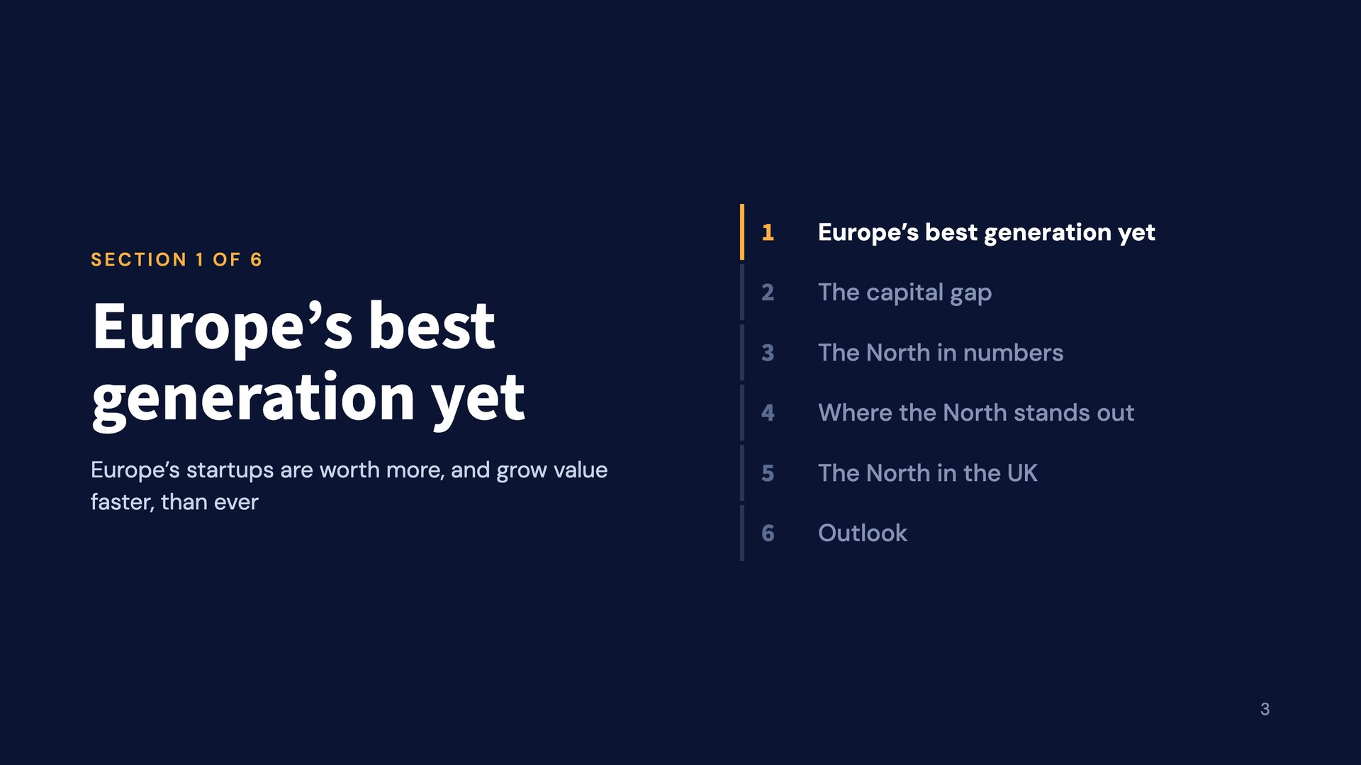
Notes:
Europe’s best generation yet

Slide 4
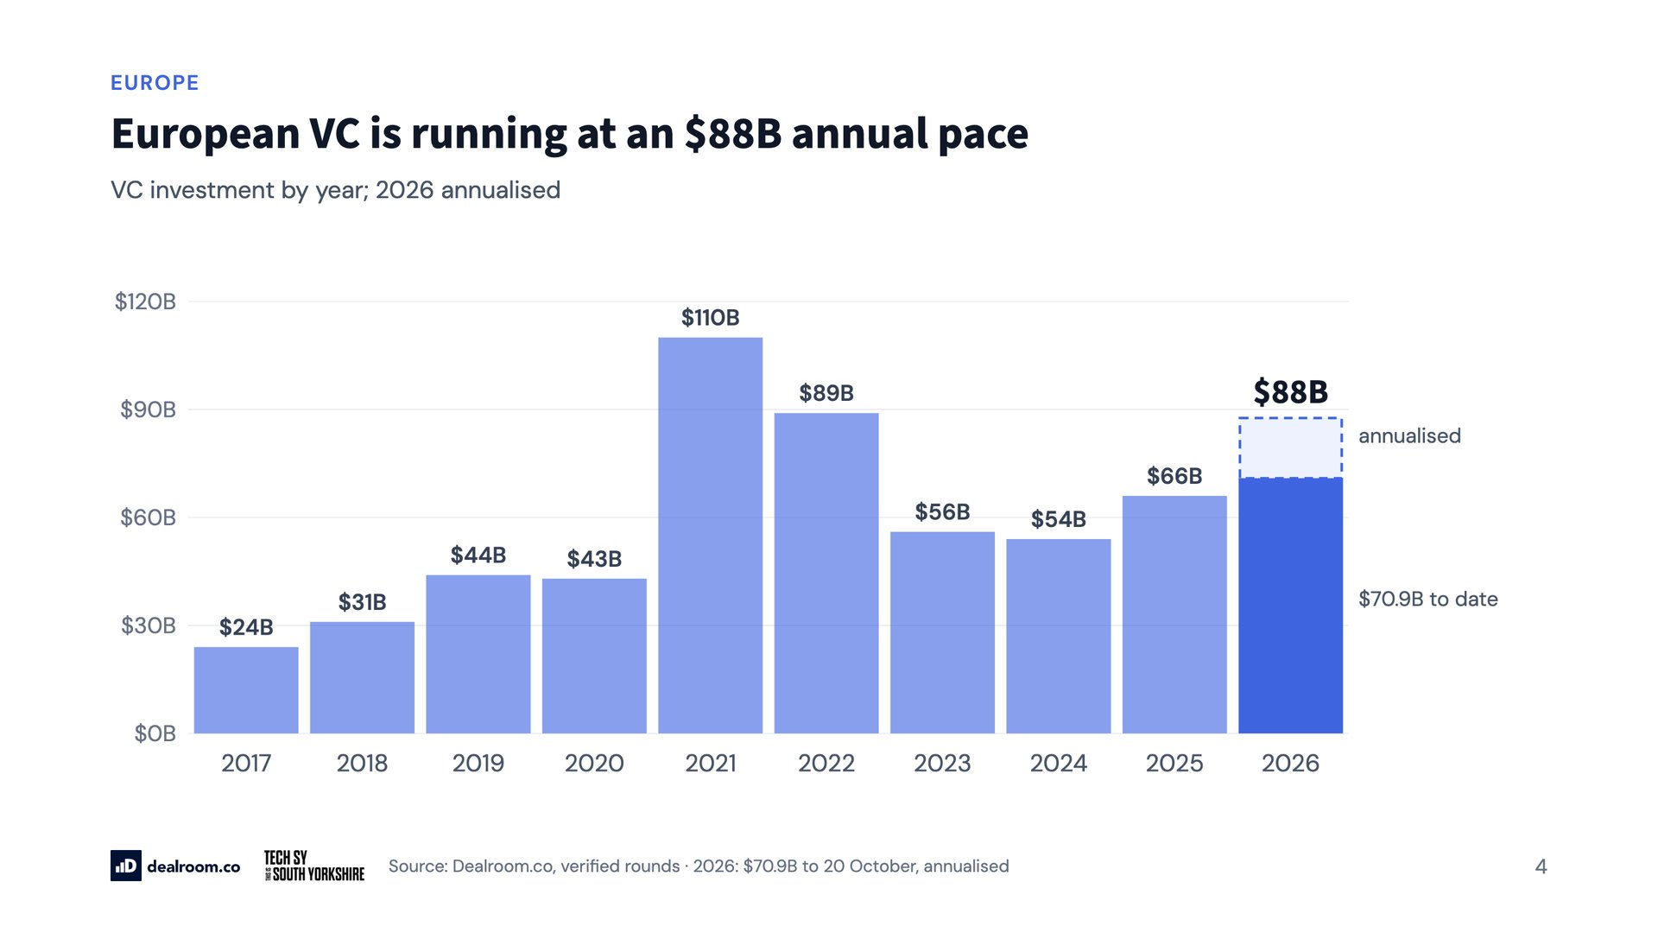
Notes:
European VC is running at an $88B annual pace

Slide 5
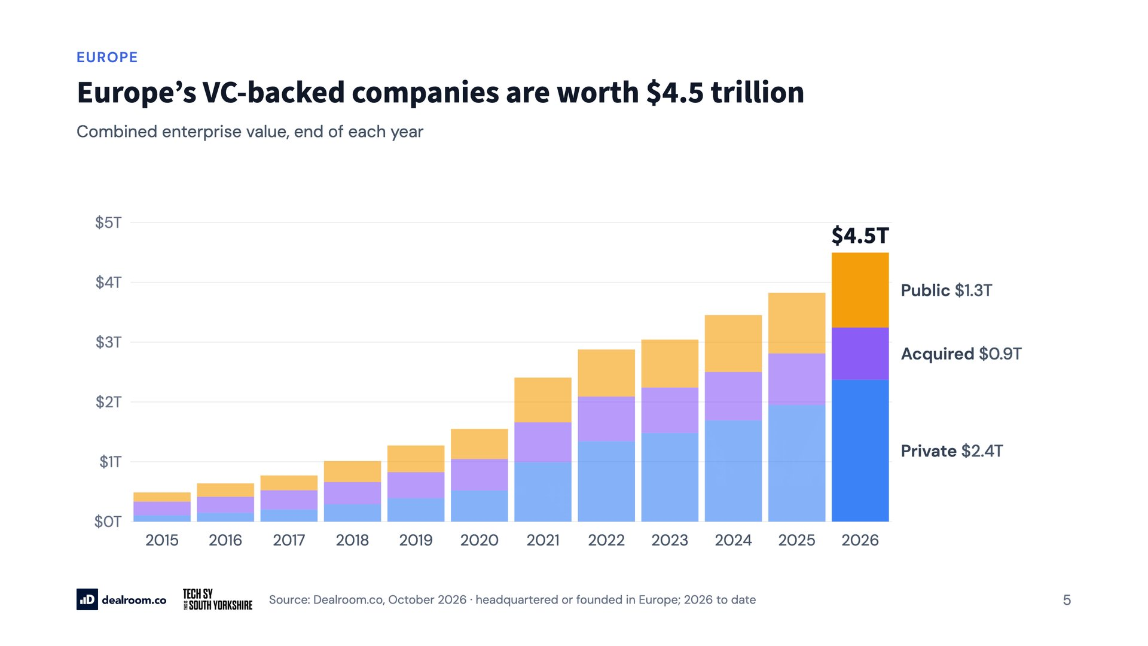
Notes:
Europe’s VC-backed companies are worth $4.5 trillion

Slide 6
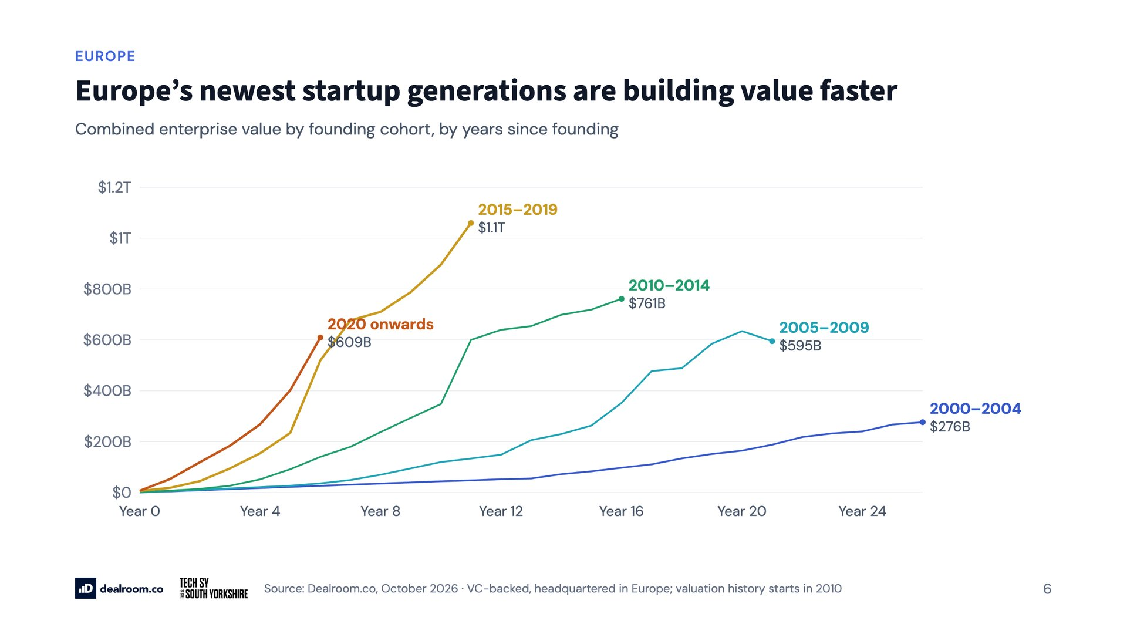
Notes:
Europe’s newest startup generations are building value faster

Slide 7
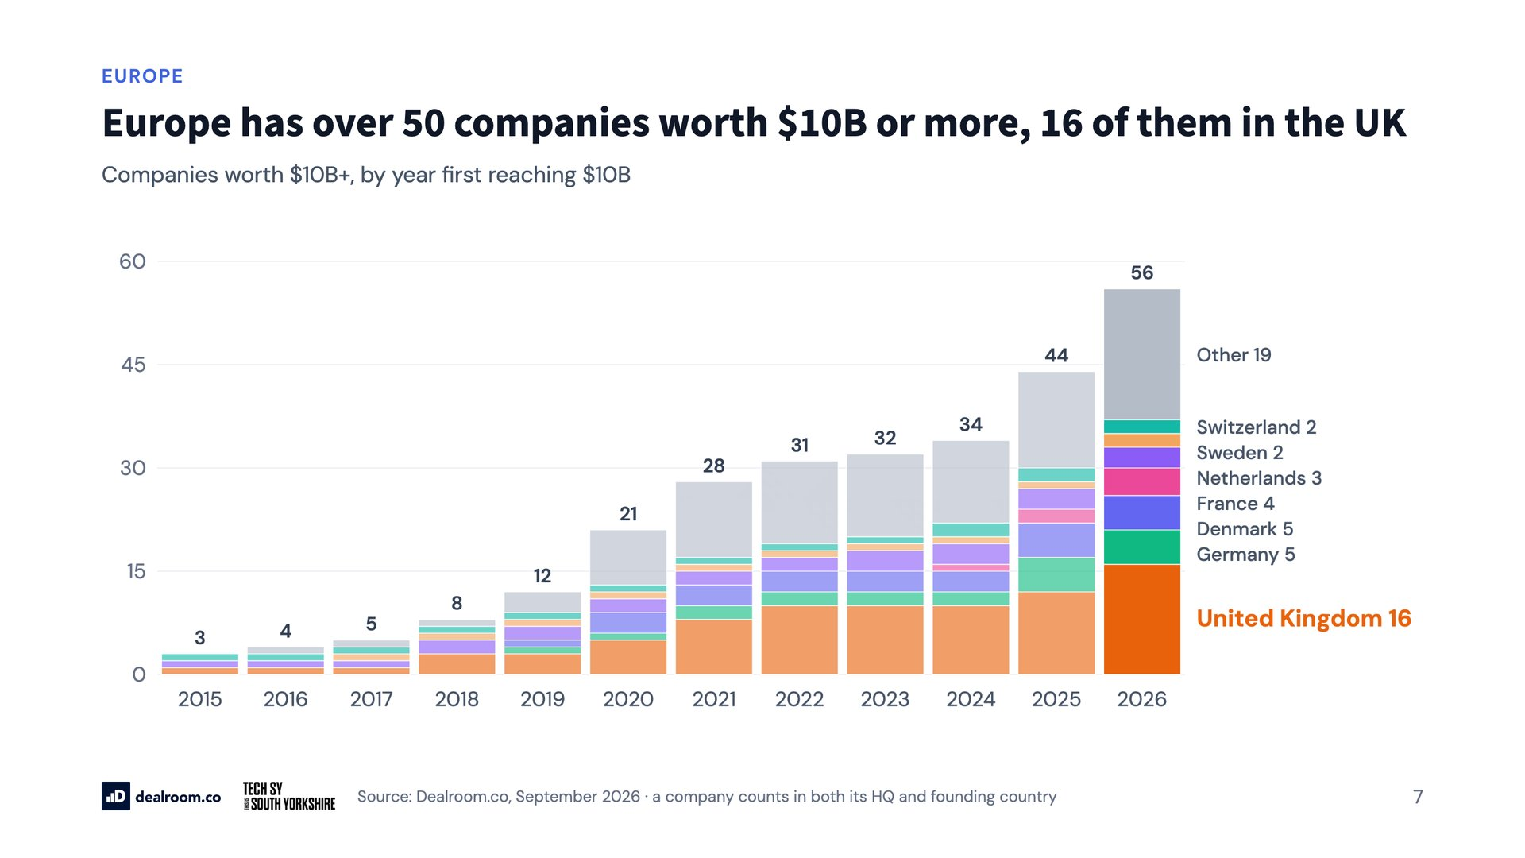
Notes:
Europe has over 50 companies worth $10B or more, 16 of them in the UK

Slide 8
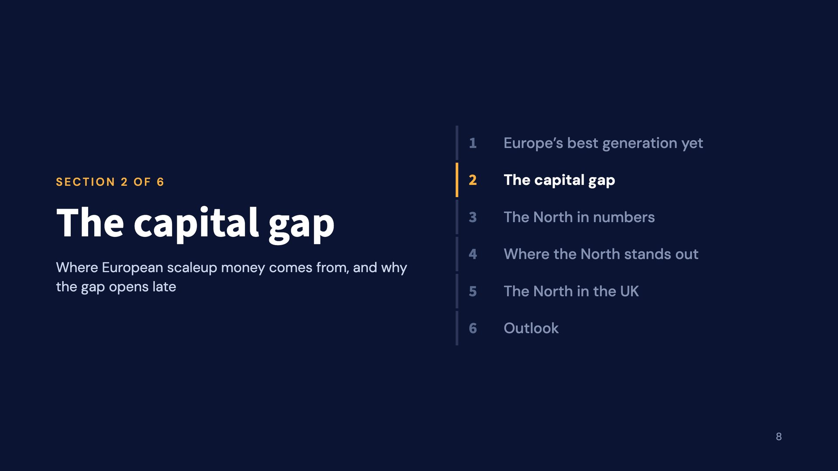
Notes:
The capital gap

Slide 9
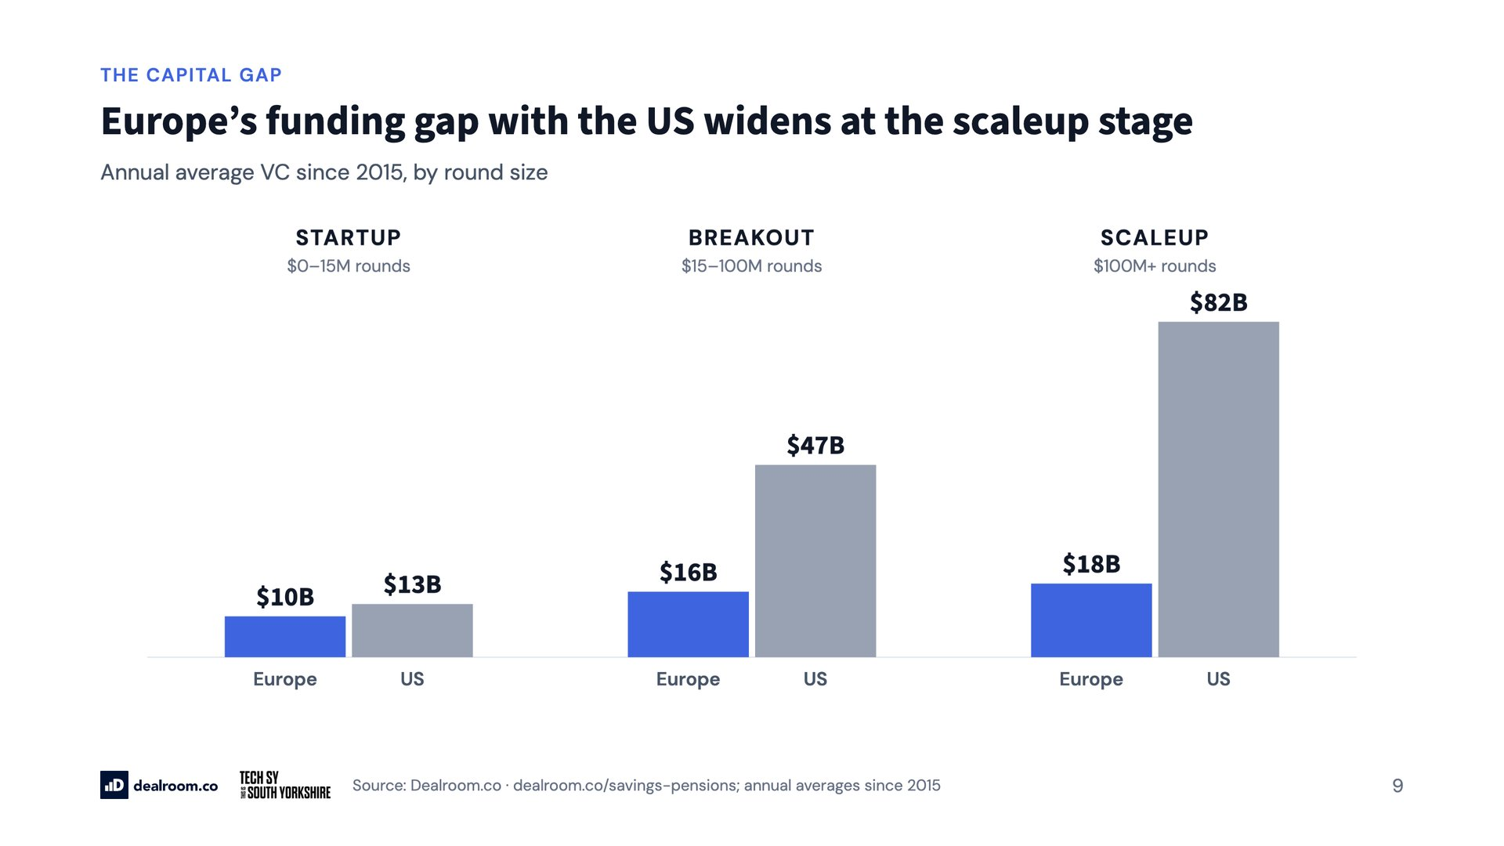
Notes:
Europe’s funding gap with the US widens at the scaleup stage

Slide 10
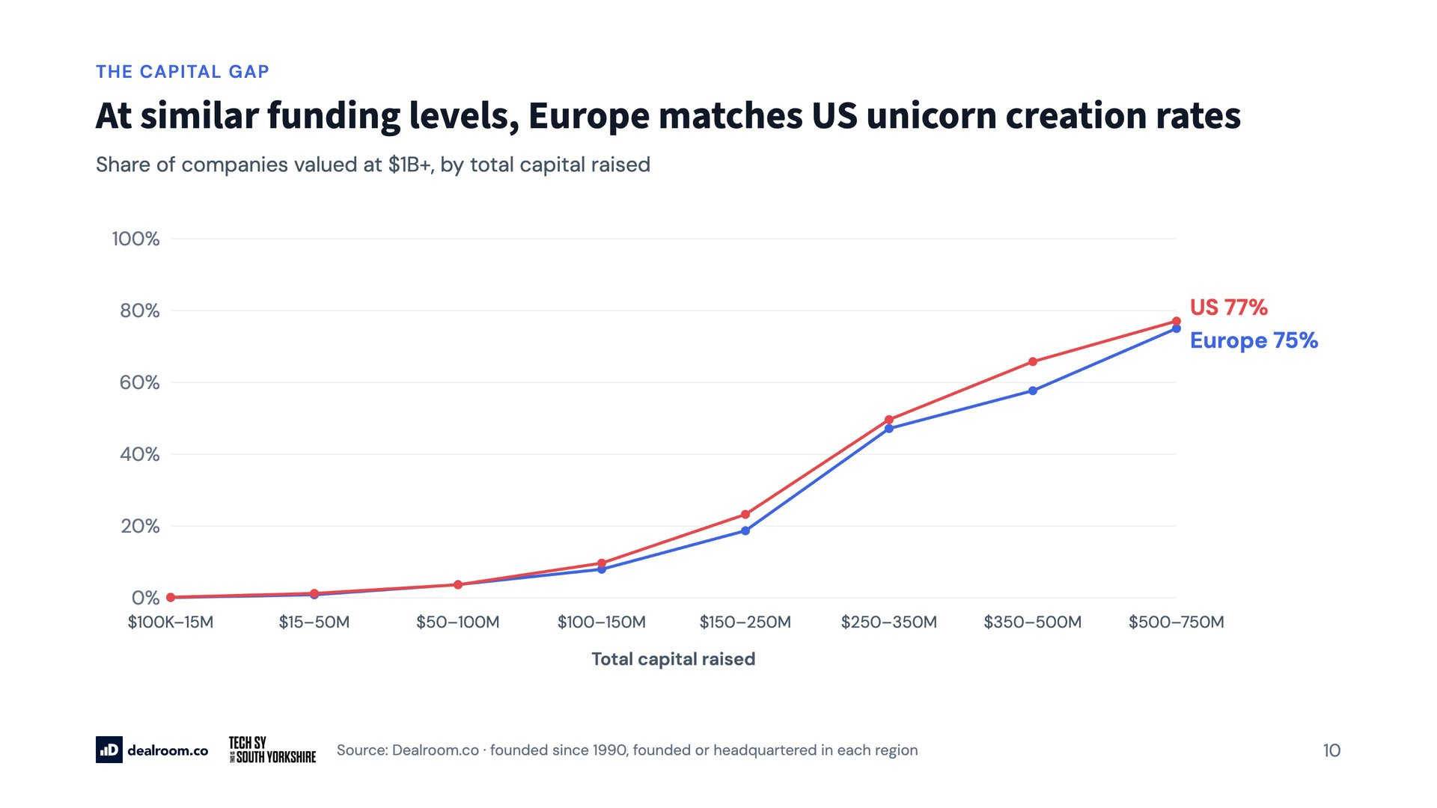
Notes:
At similar funding levels, Europe matches US unicorn creation rates

Slide 11
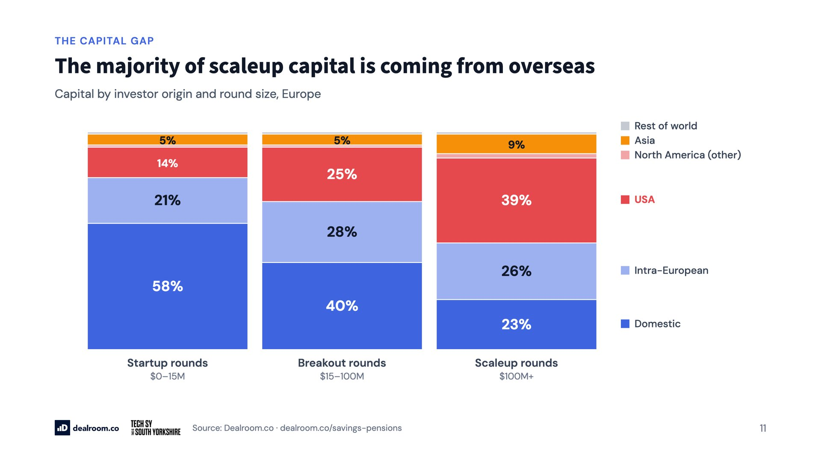
Notes:
The majority of scaleup capital is coming from overseas

Slide 12
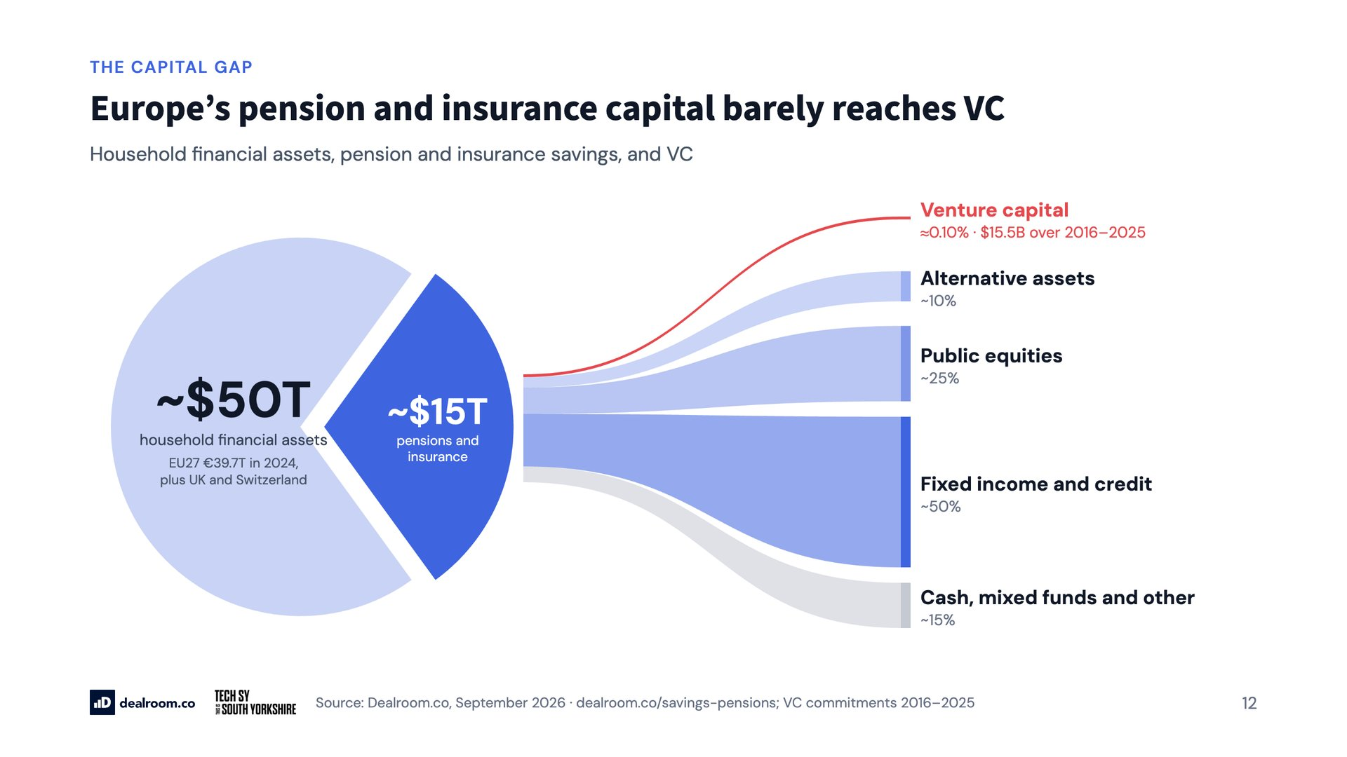
Notes:
Europe’s pension and insurance capital barely reaches VC

Slide 13
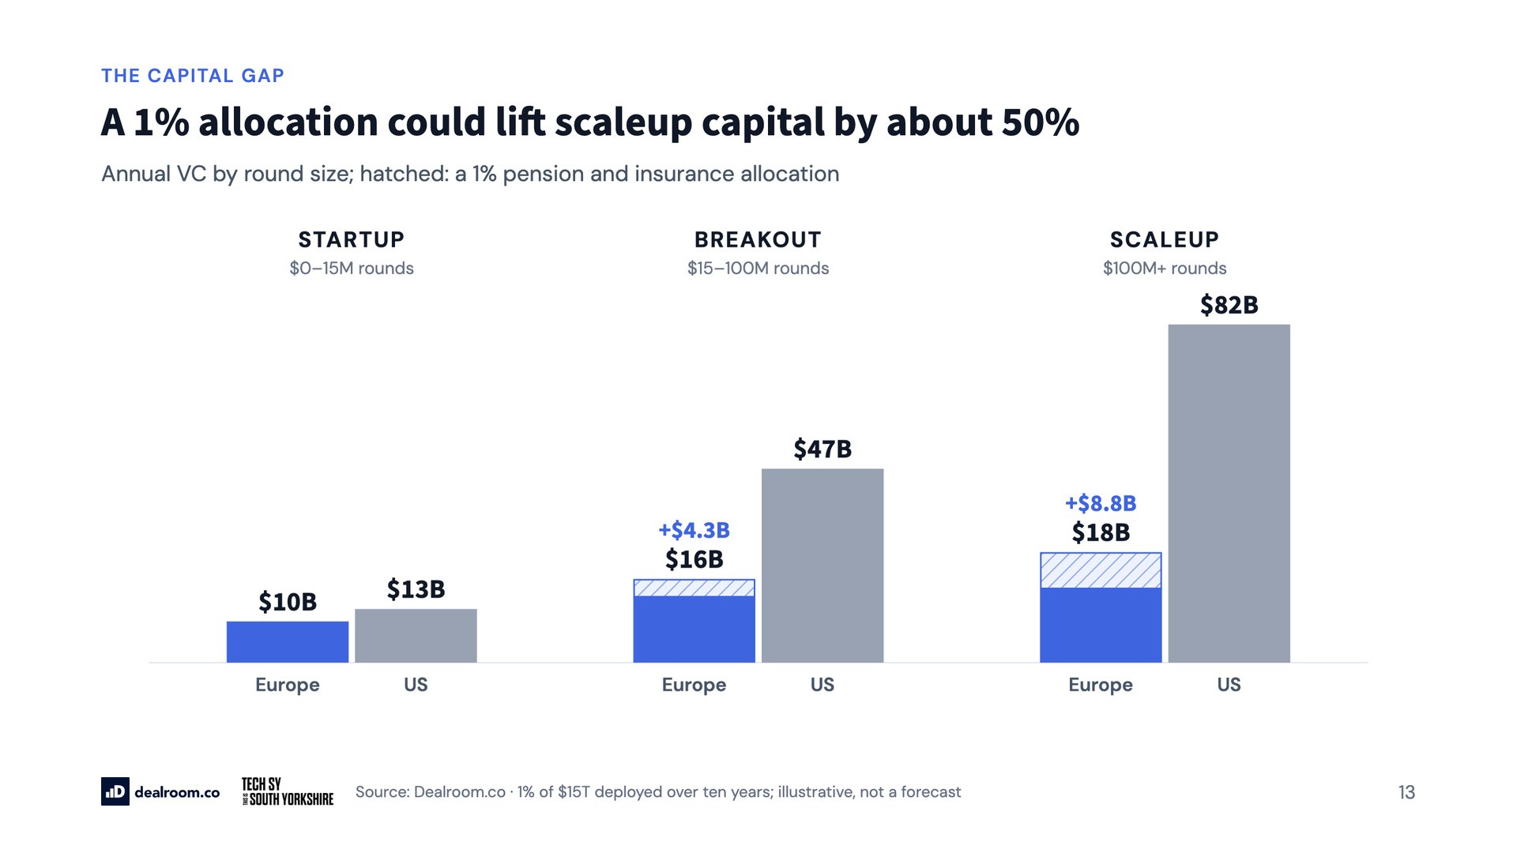
Notes:
A 1% allocation could lift scaleup capital by about 50%

Slide 14
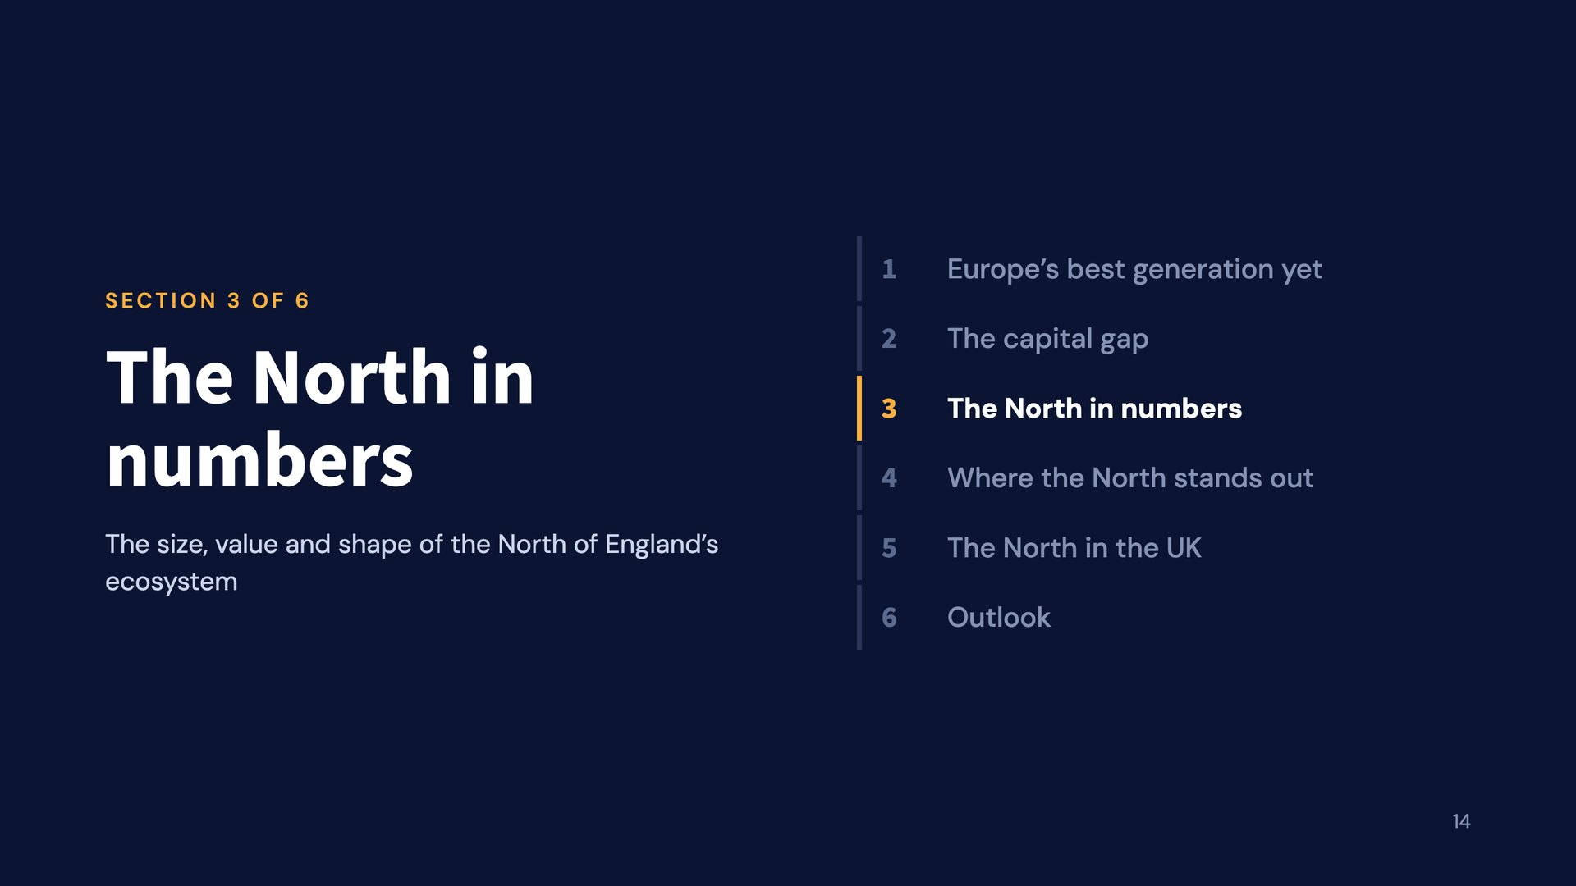
Notes:
The North in numbers

Slide 15
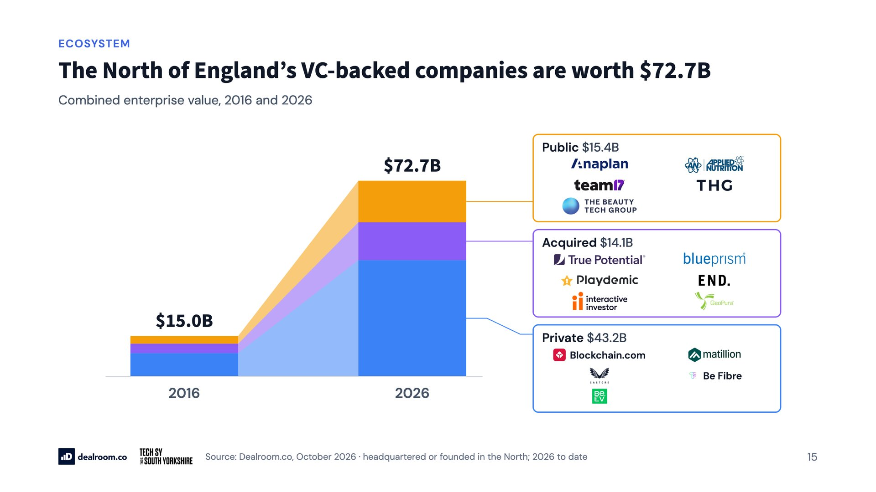
Notes:
The North of England’s VC-backed companies are worth $72.7B

Slide 16
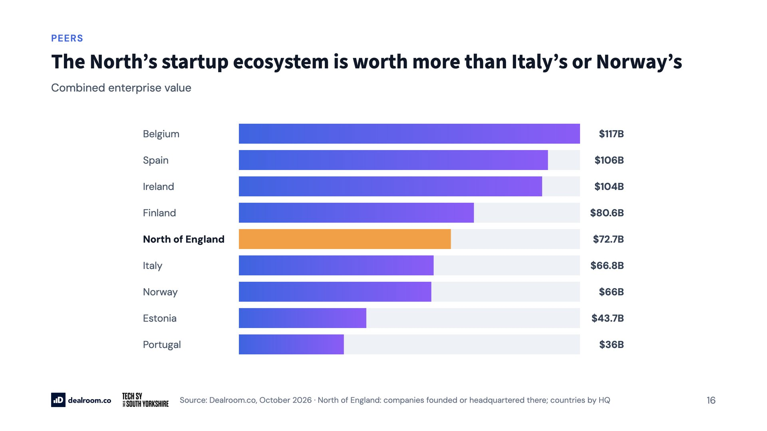
Notes:
The North’s startup ecosystem is worth more than Italy’s or Norway’s

Slide 17
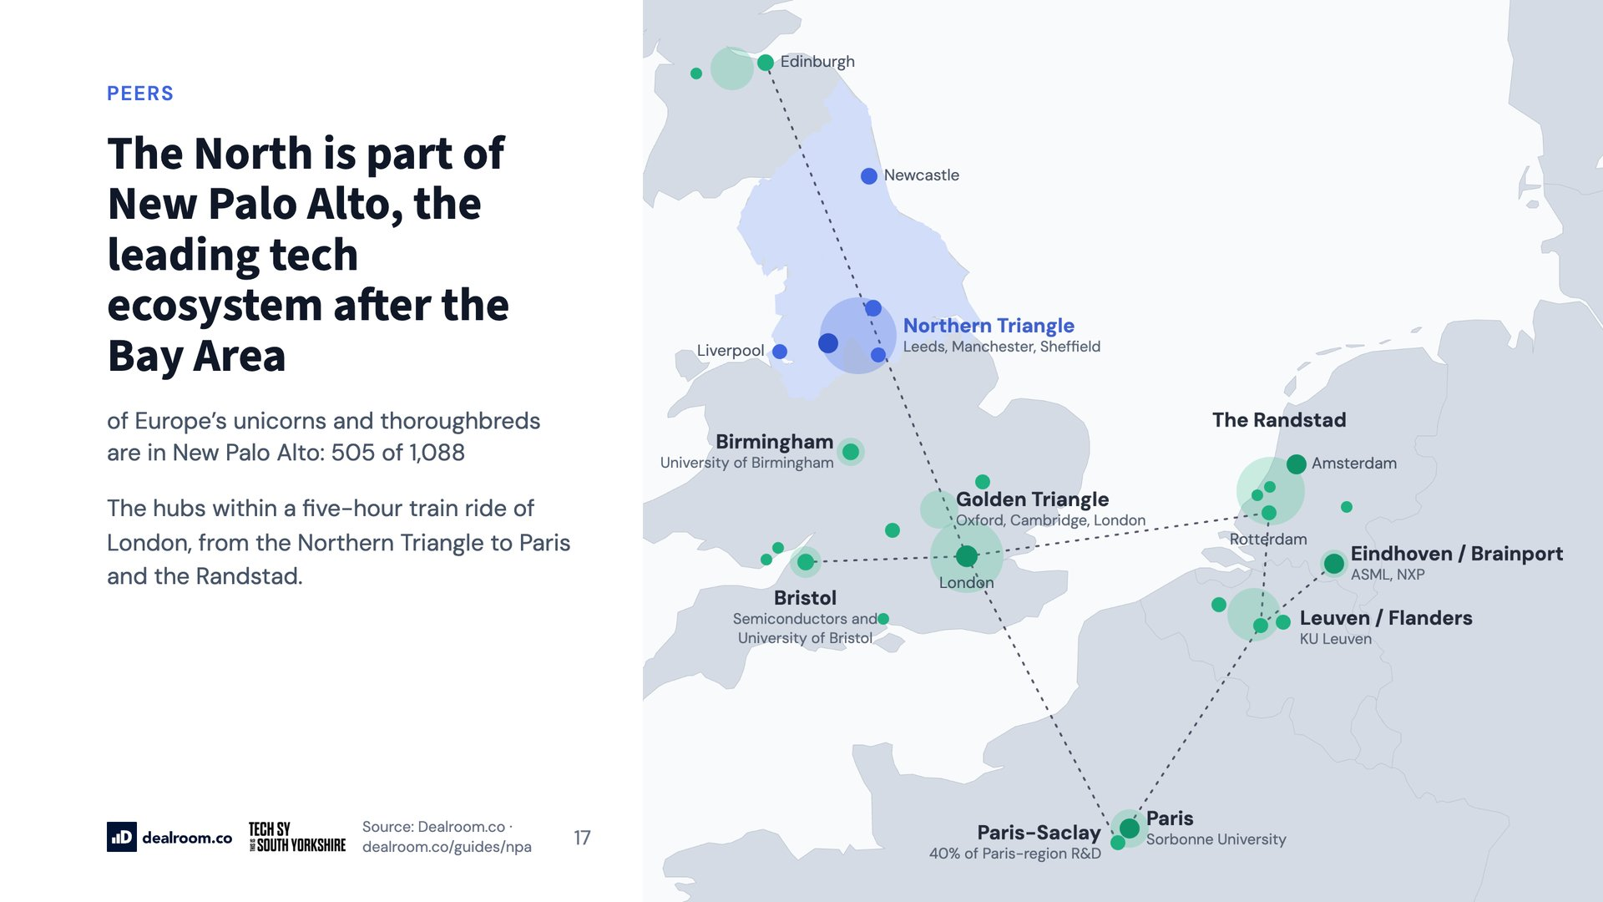
Notes:
The North is part of New Palo Alto, the leading tech ecosystem after the Bay Area

Slide 18
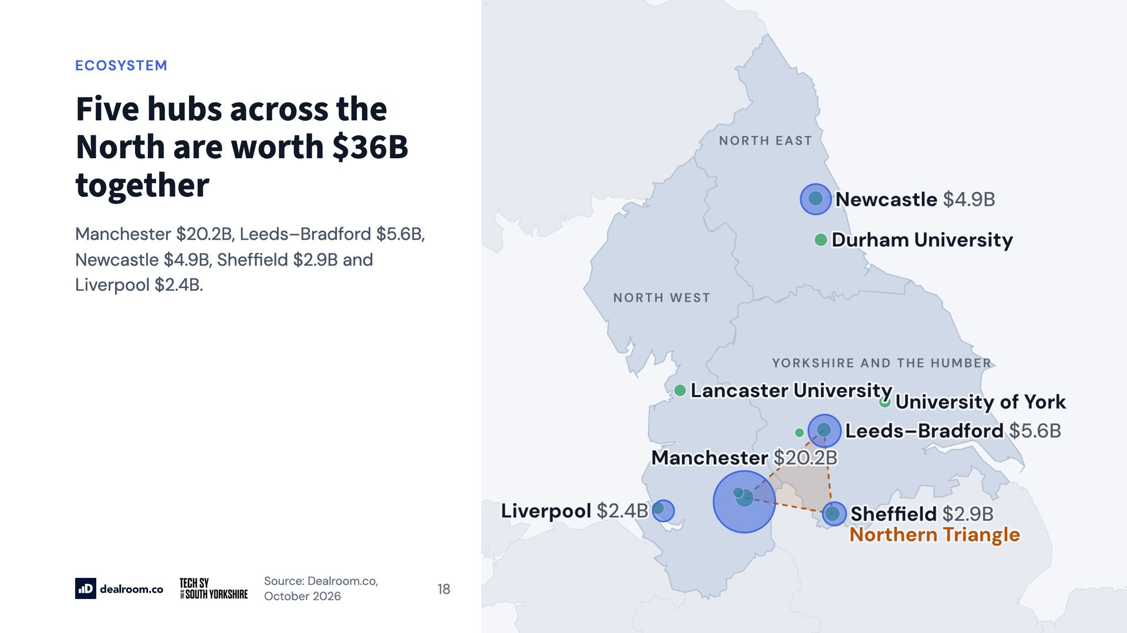
Notes:
Five hubs across the North are worth $36B together

Slide 19
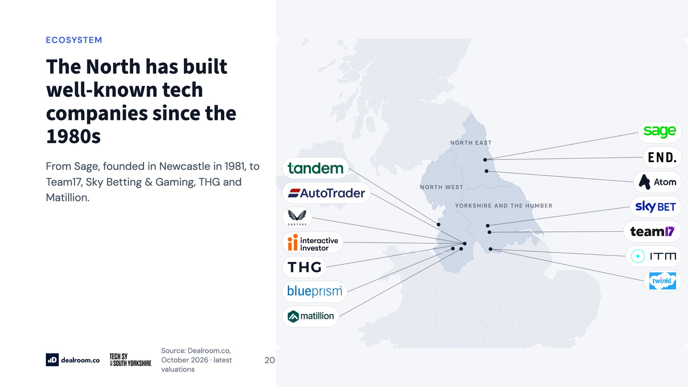
Notes:
The North has built well-known tech companies since the 1980s

Slide 20
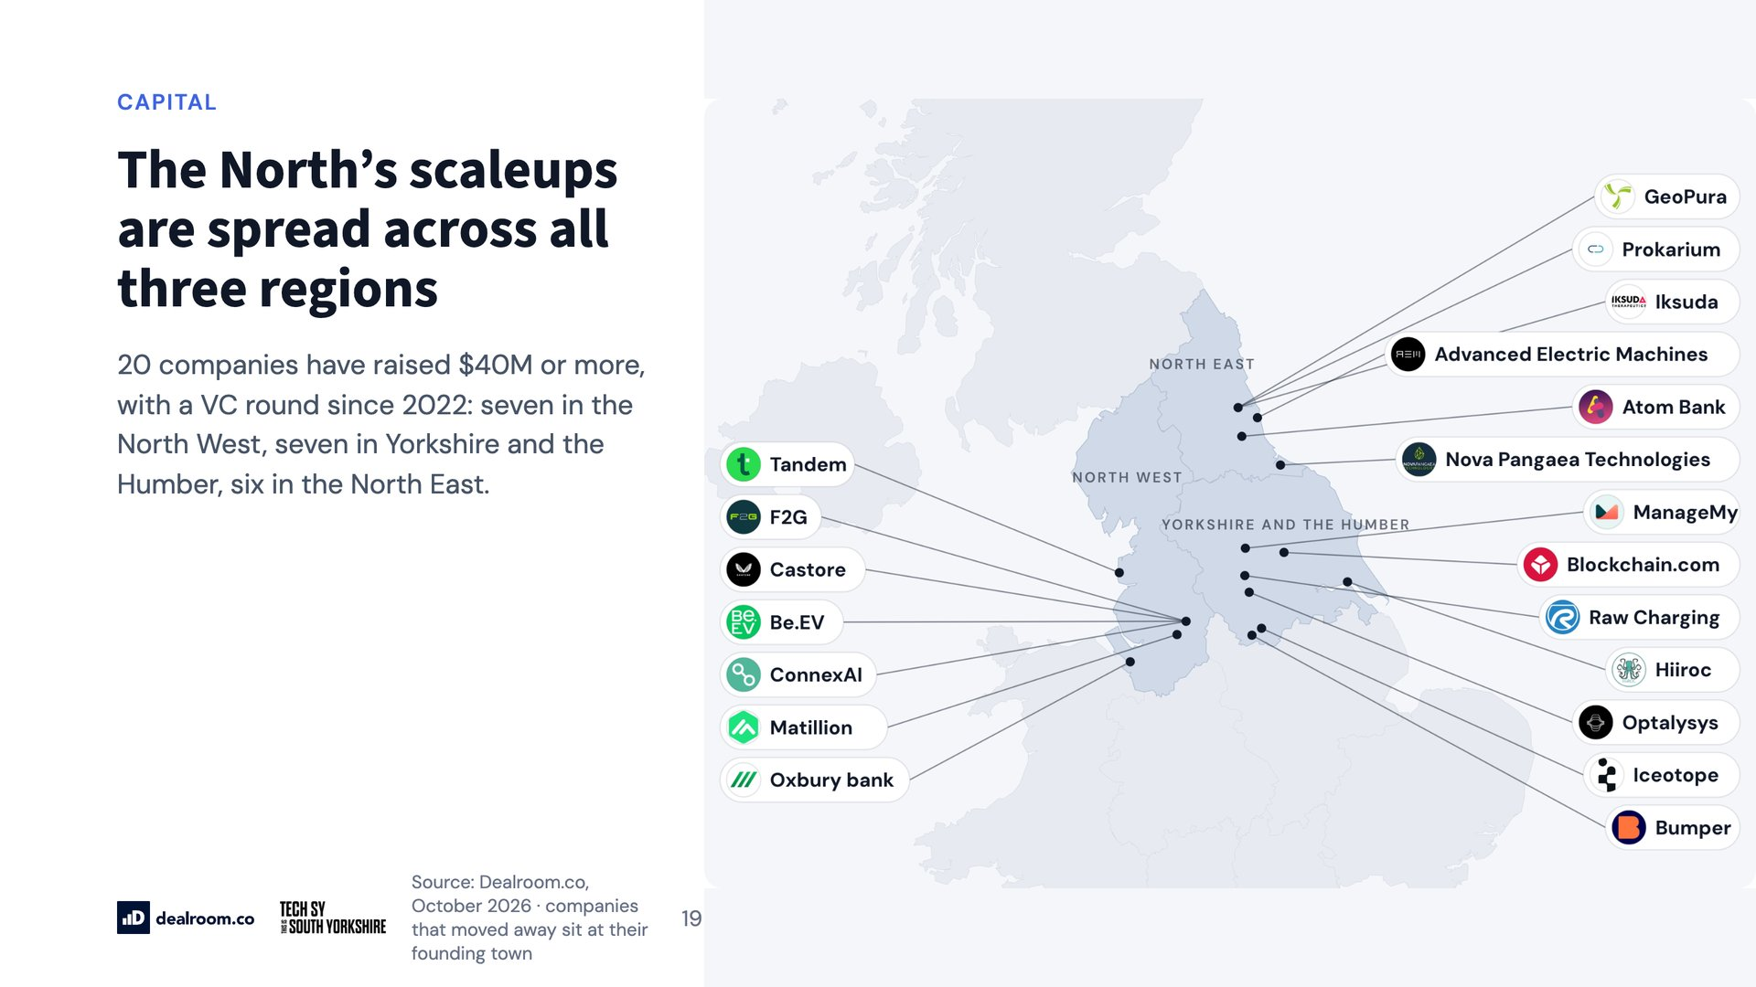
Notes:
The North’s scaleups are spread across all three regions

Slide 21
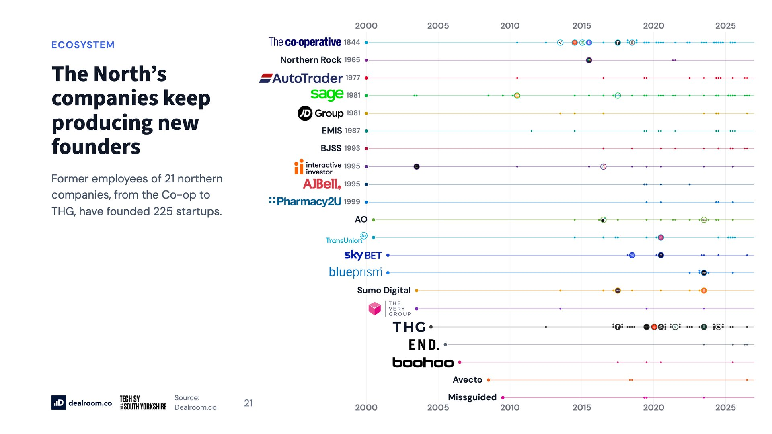
Notes:
The North’s companies keep producing new founders

Slide 22
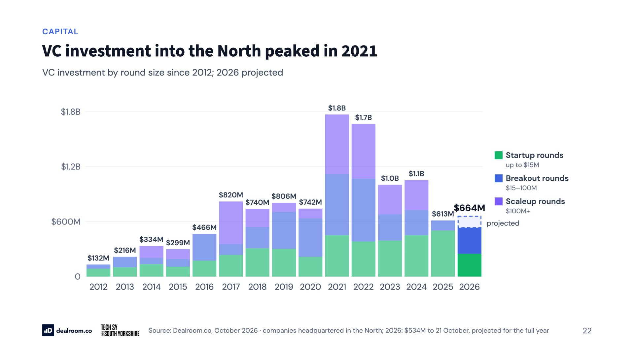
Notes:
VC investment into the North peaked in 2021

Slide 23
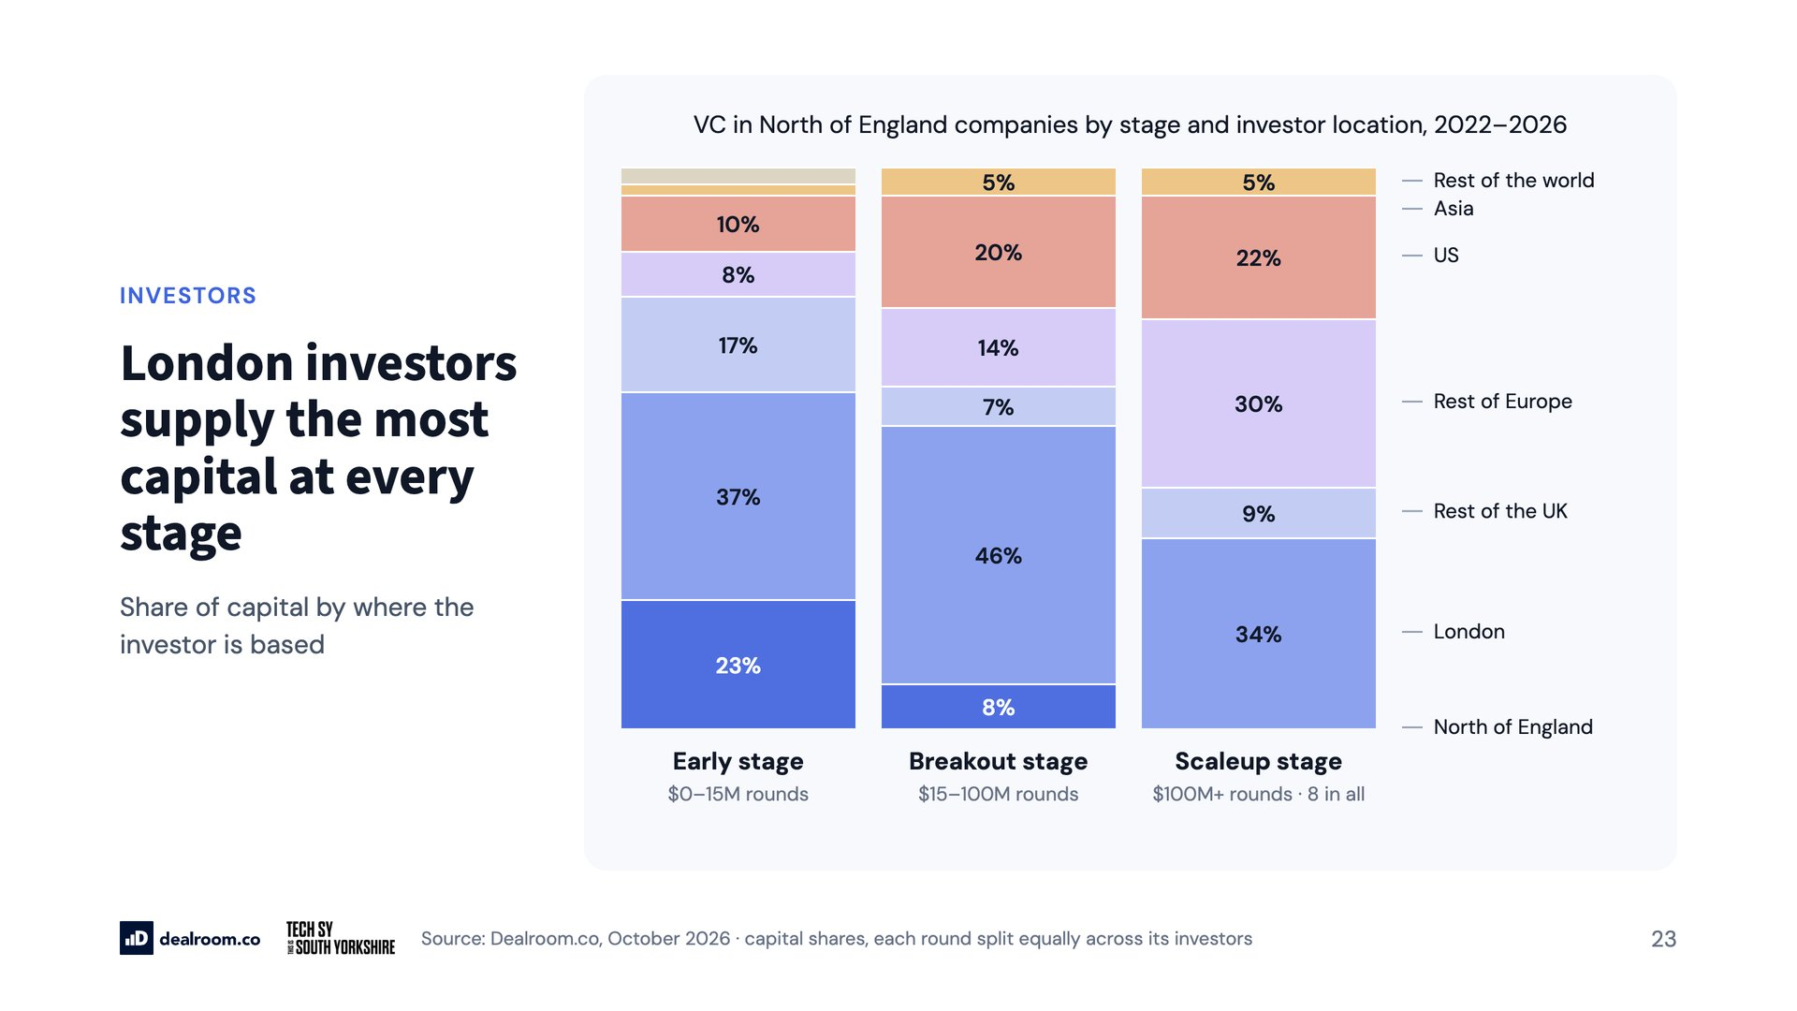
Notes:
London investors supply the most capital at every stage

Slide 24
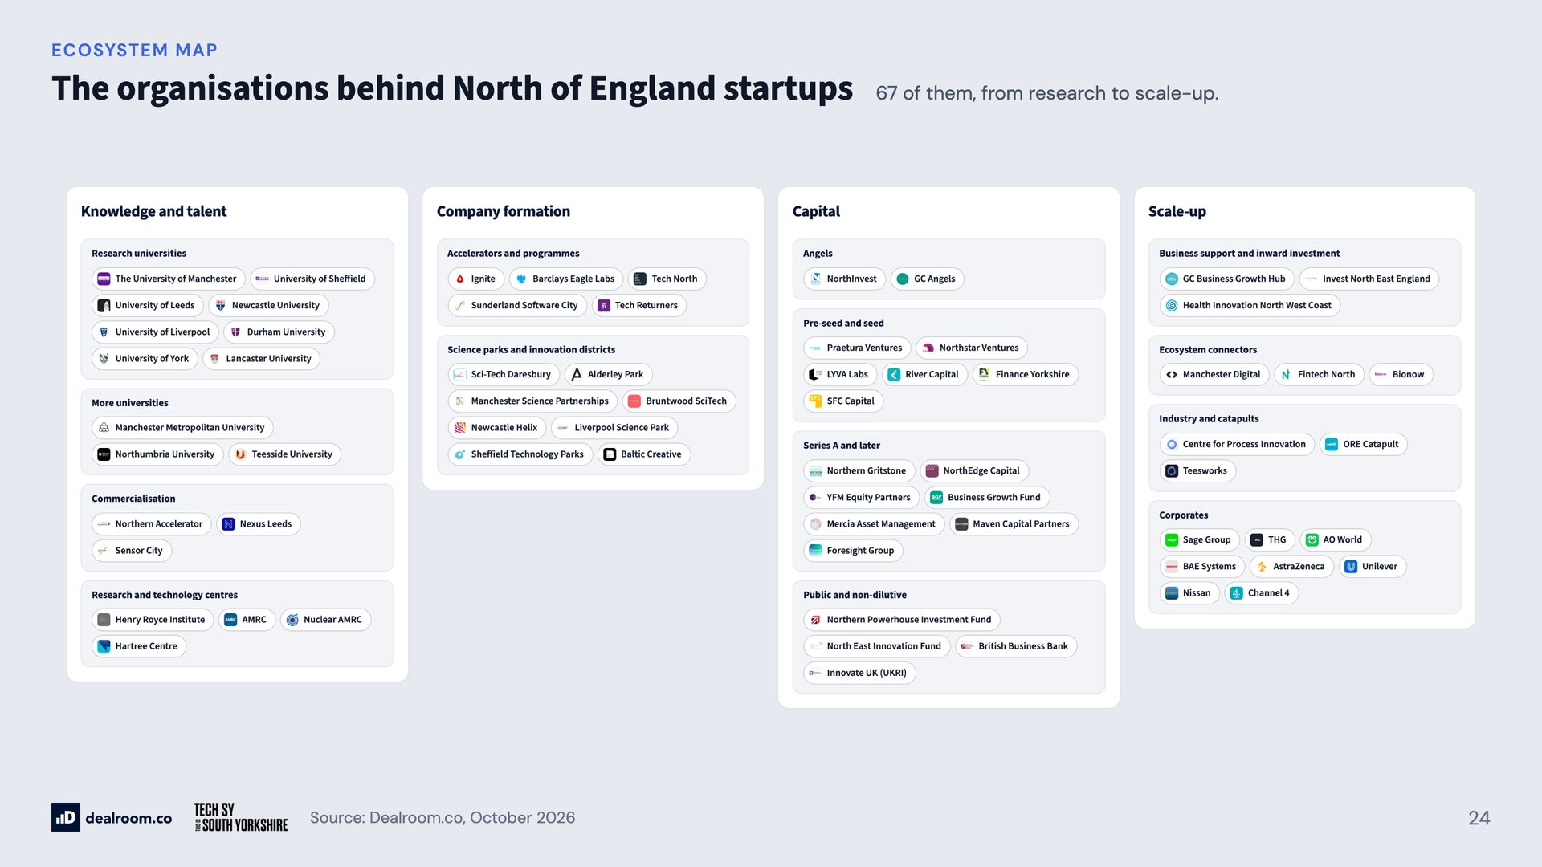
Notes:
The organisations behind North of England startups

Slide 25
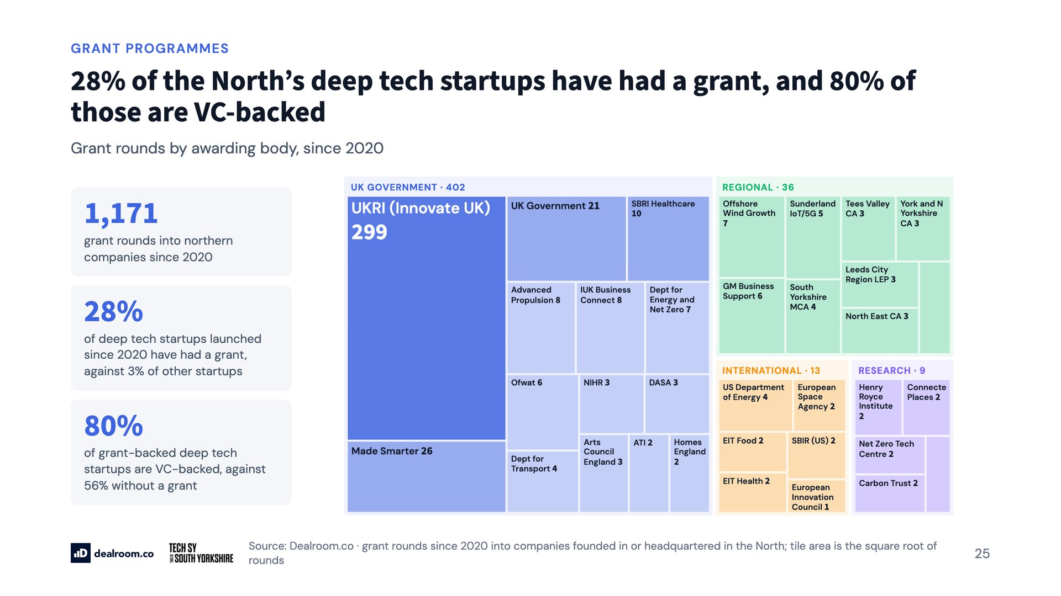
Notes:
28% of the North’s deep tech startups have had a grant, and 80% of those are VC-backed

Slide 26
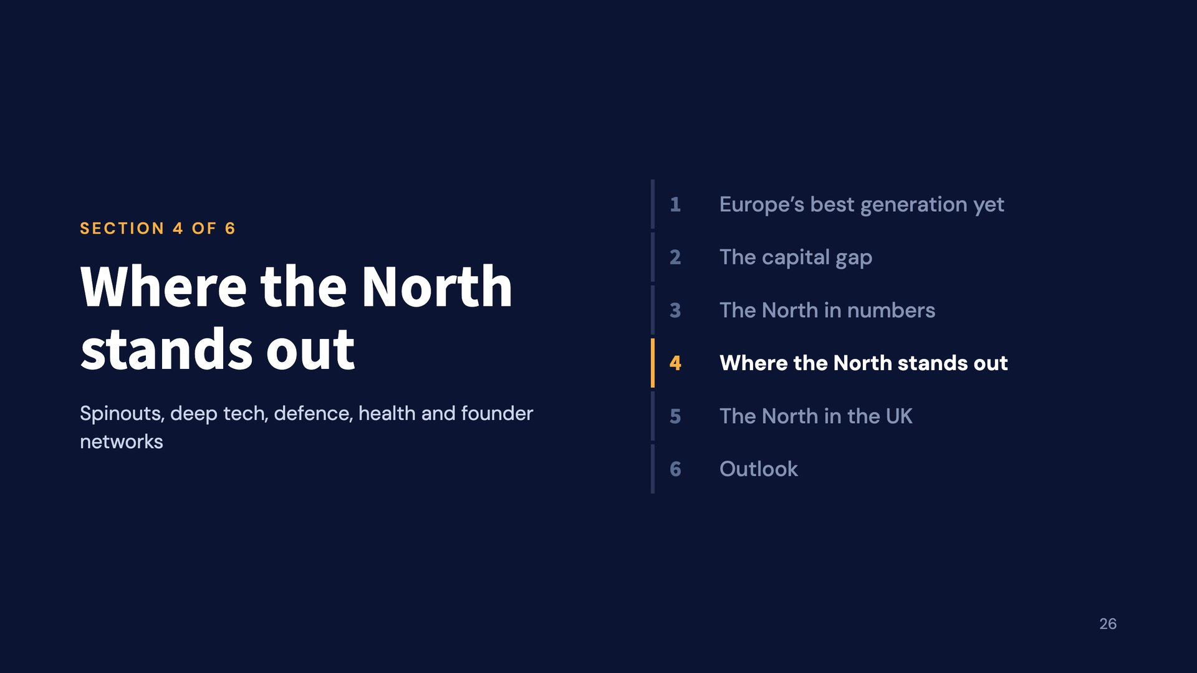
Notes:
Where the North stands out

Slide 27
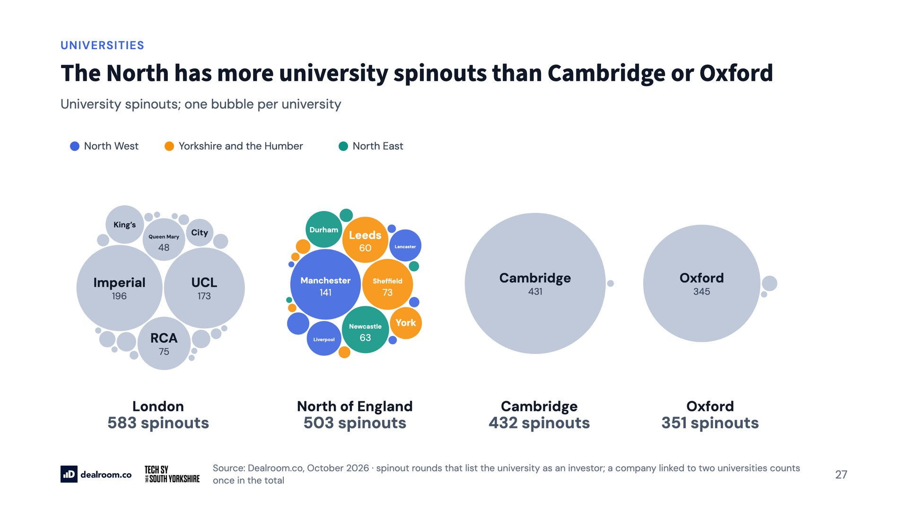
Notes:
The North has more university spinouts than Cambridge or Oxford

Slide 28
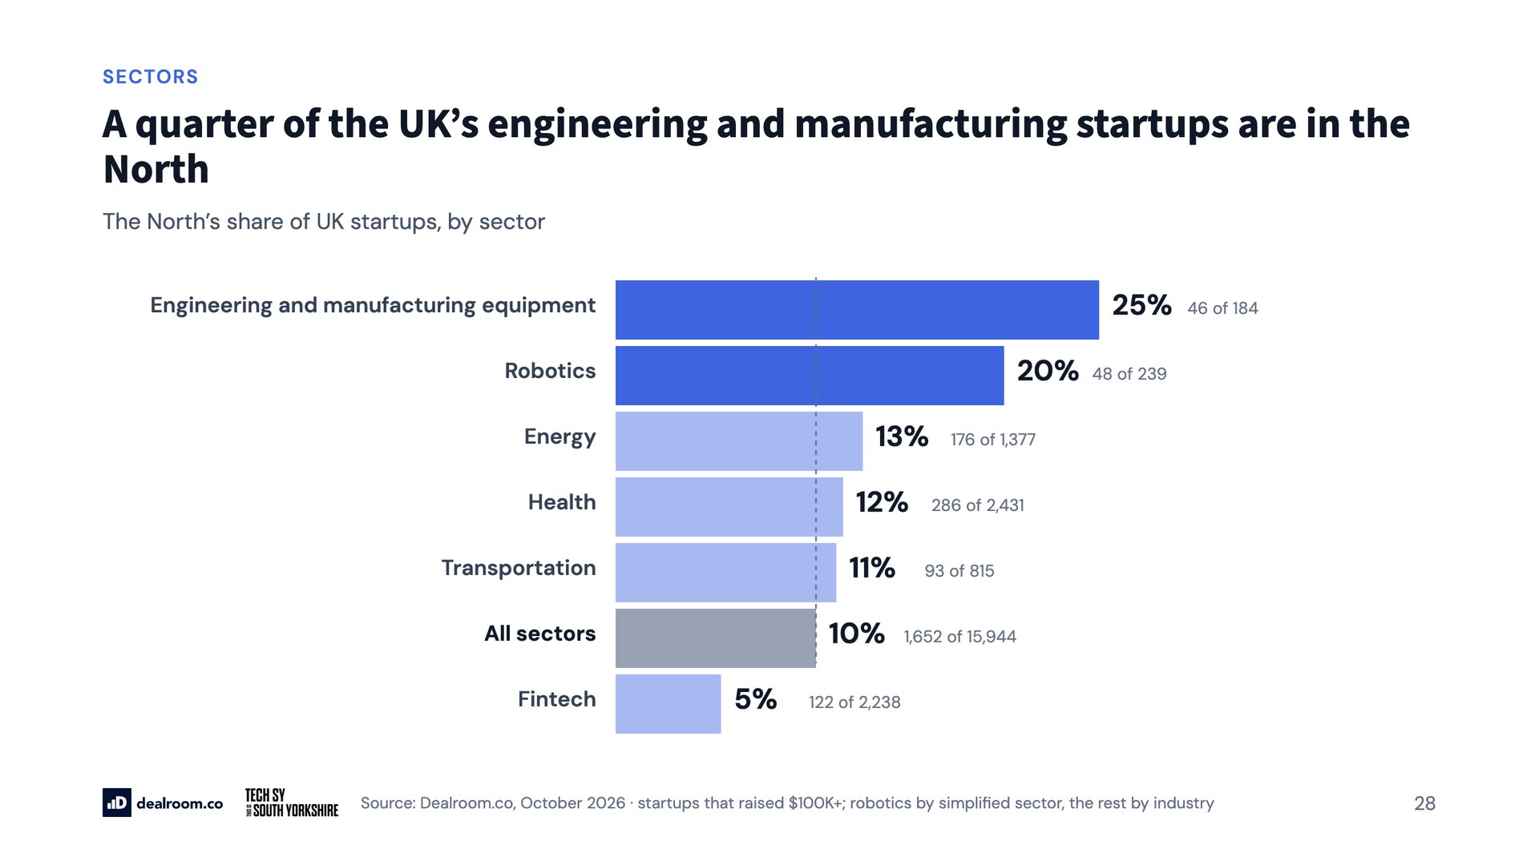
Notes:
A quarter of the UK’s engineering and manufacturing startups are in the North

Slide 29
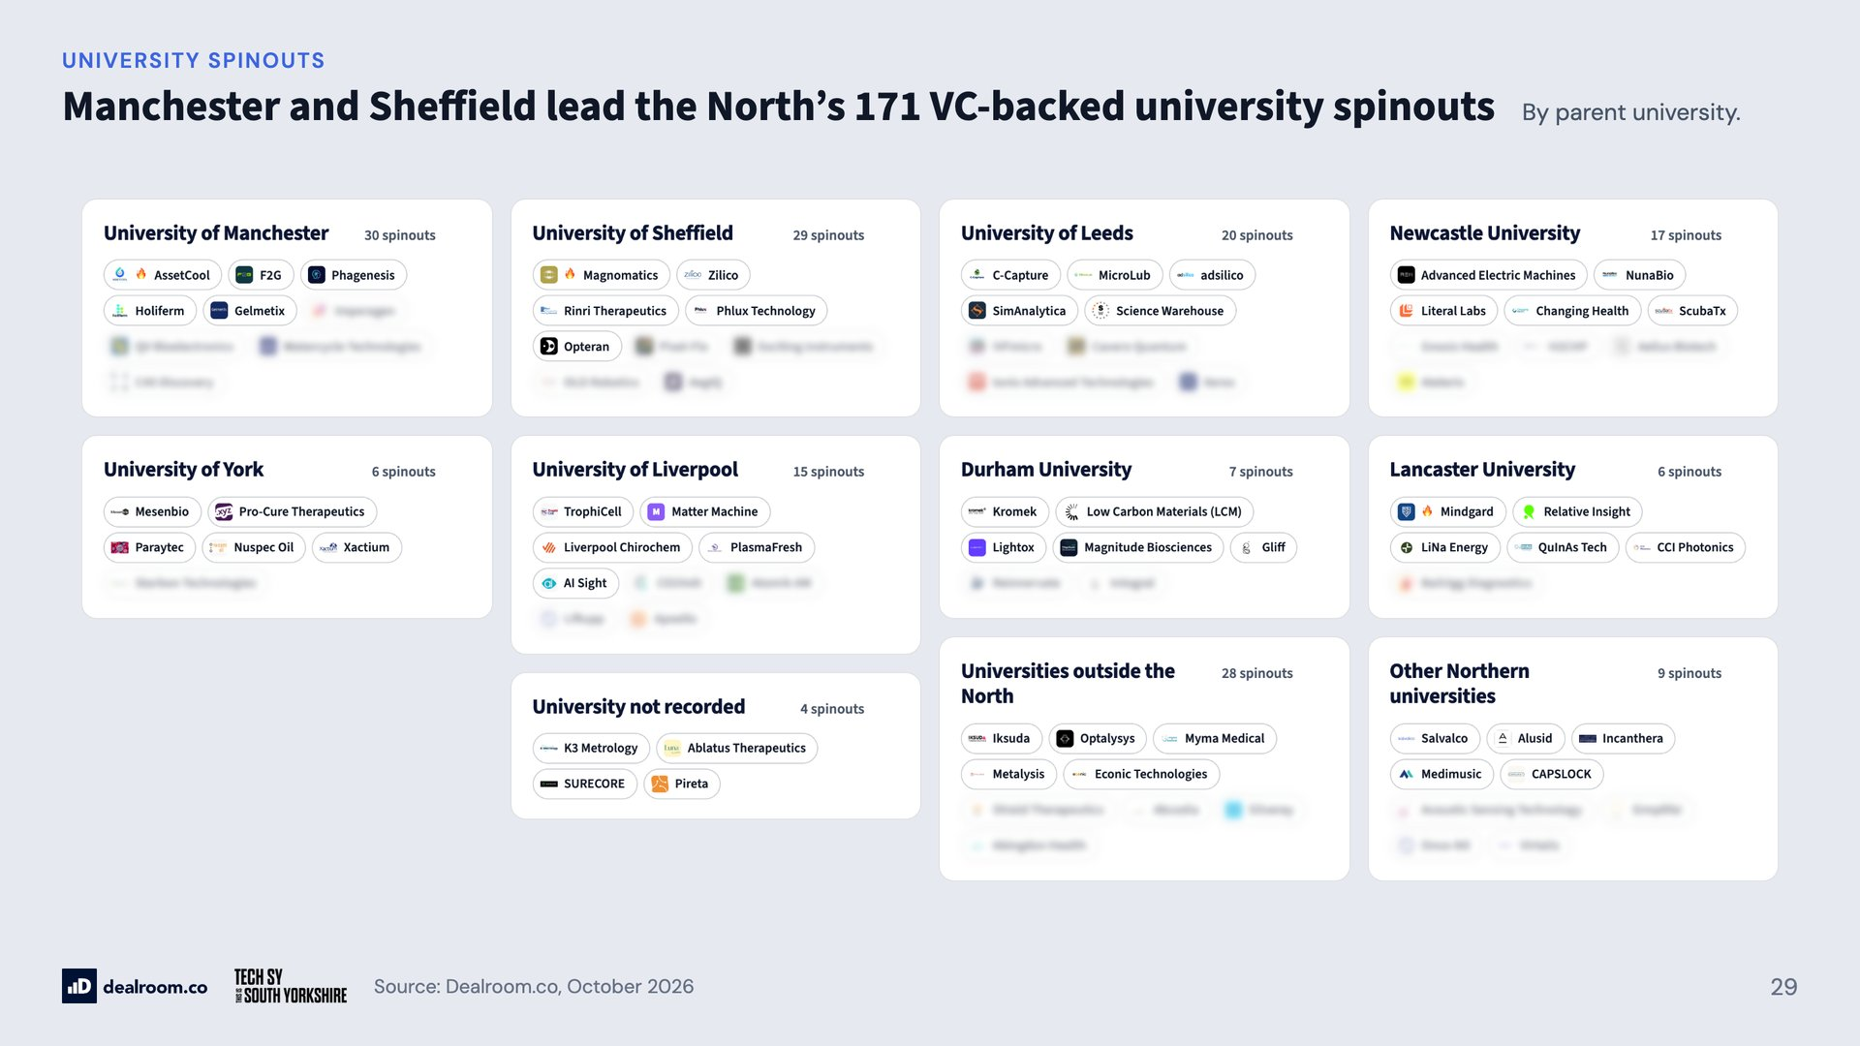
Notes:
Manchester and Sheffield lead the North’s 171 VC-backed university spinouts

Slide 30
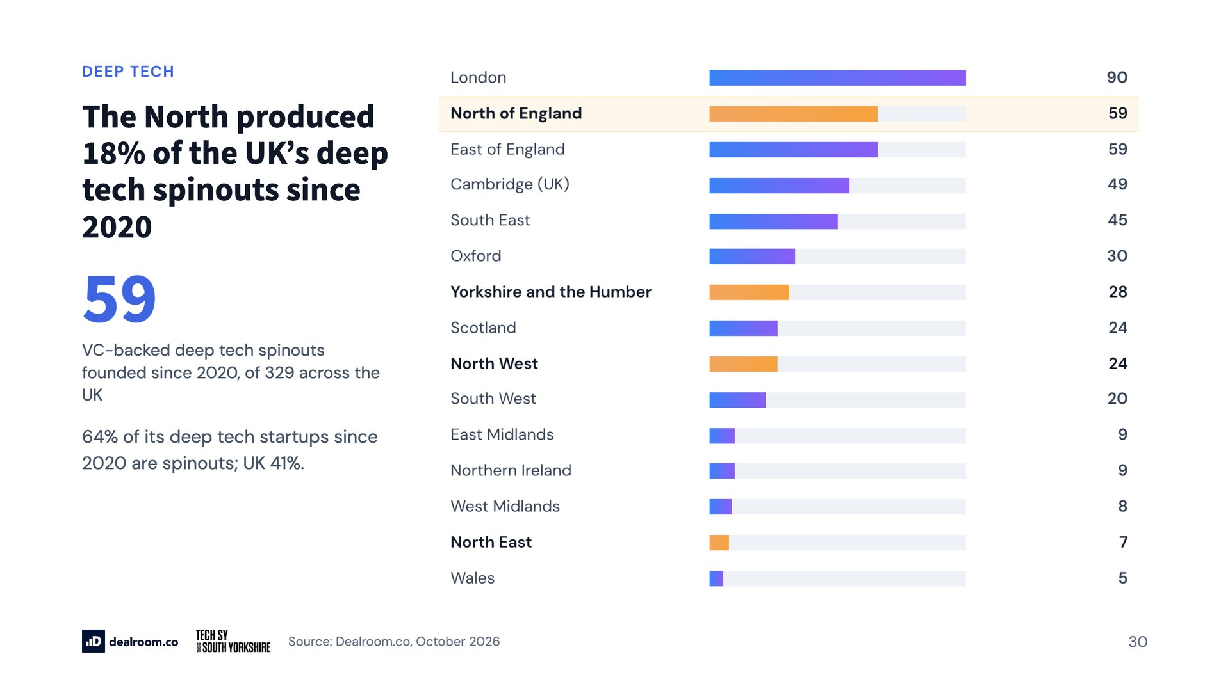
Notes:
The North produced 18% of the UK’s deep tech spinouts since 2020

Slide 31
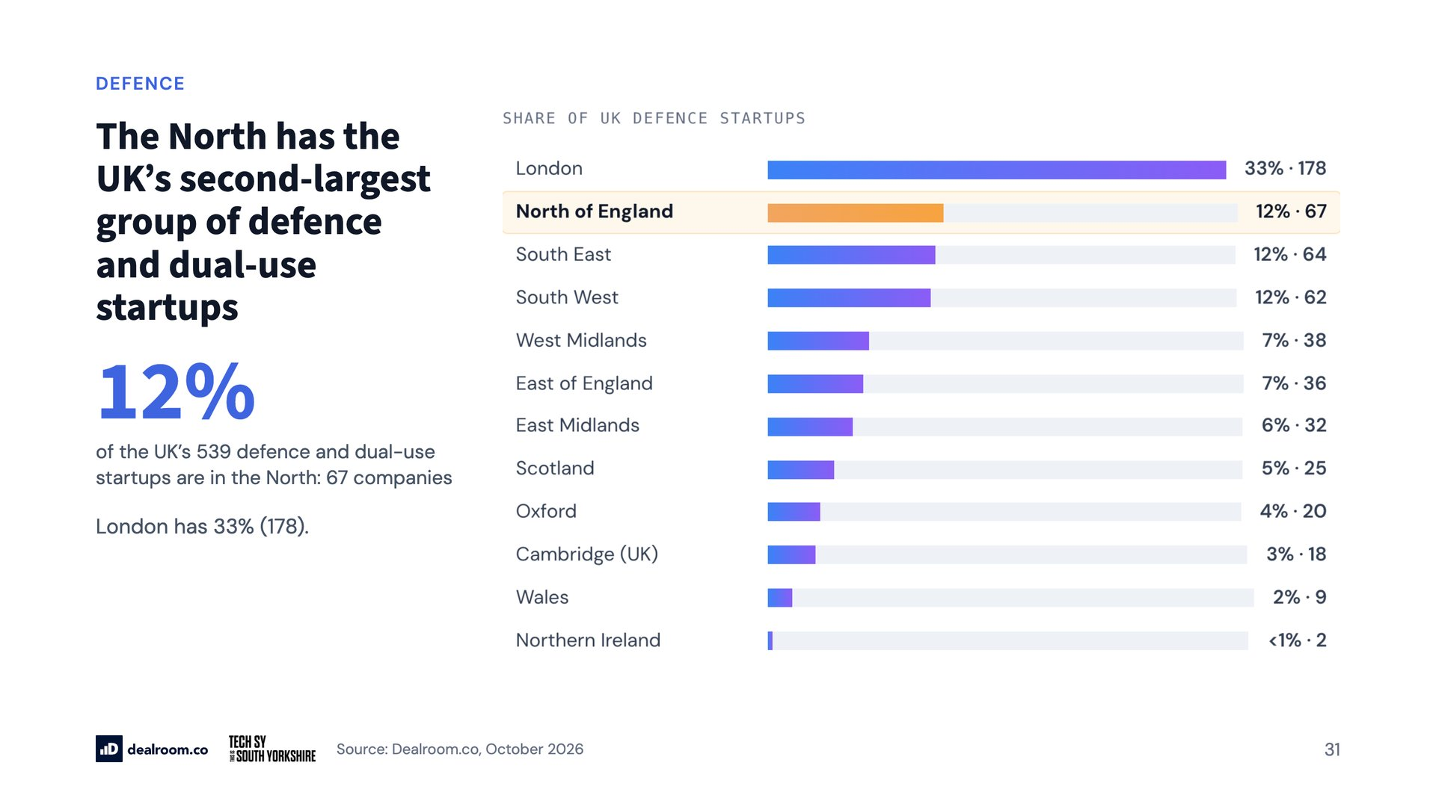
Notes:
The North has the UK’s second-largest group of defence and dual-use startups

Slide 32
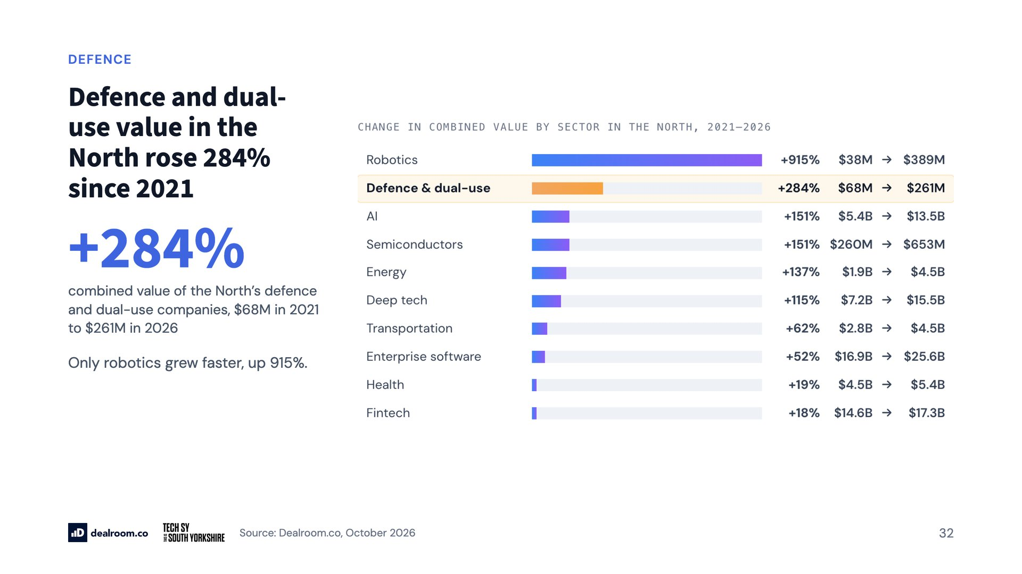
Notes:
Defence and dual-use value in the North rose 284% since 2021

Slide 33
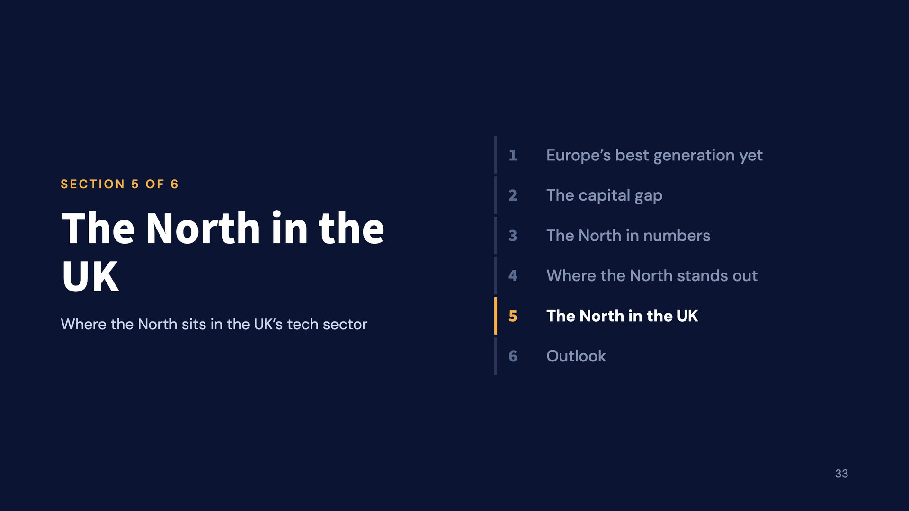
Notes:
The North in the UK

Slide 34
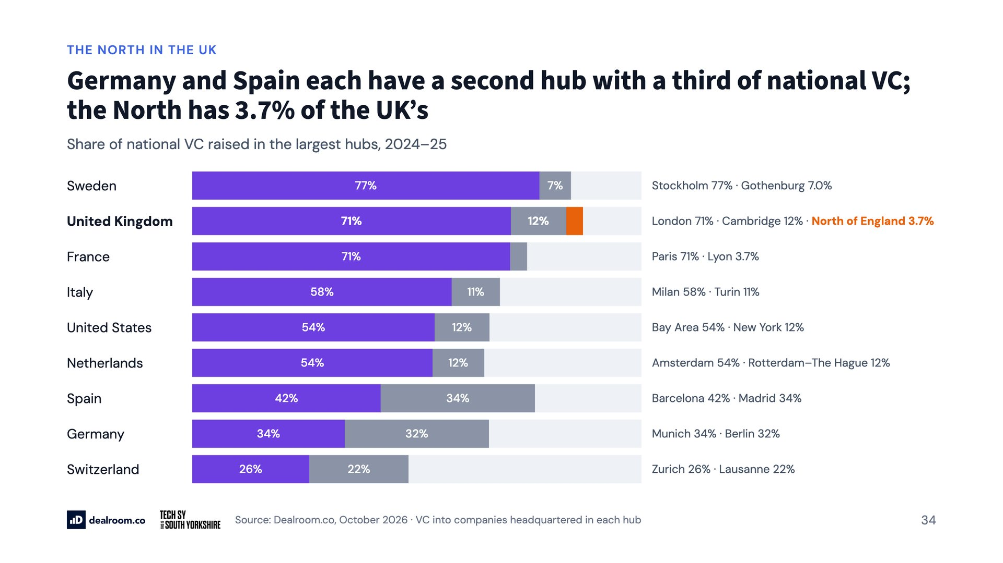
Notes:
Germany and Spain each have a second hub with a third of national VC; the North has 3.7% of the UK’s

Slide 35
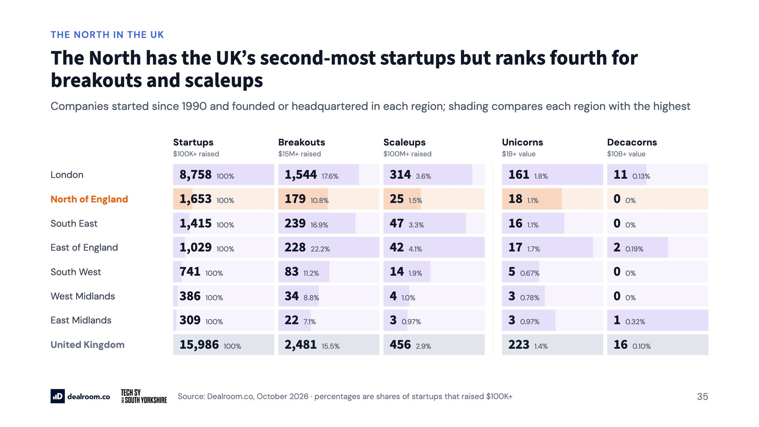
Notes:
The North has the UK’s second-most startups but ranks fourth for breakouts and scaleups

Slide 36
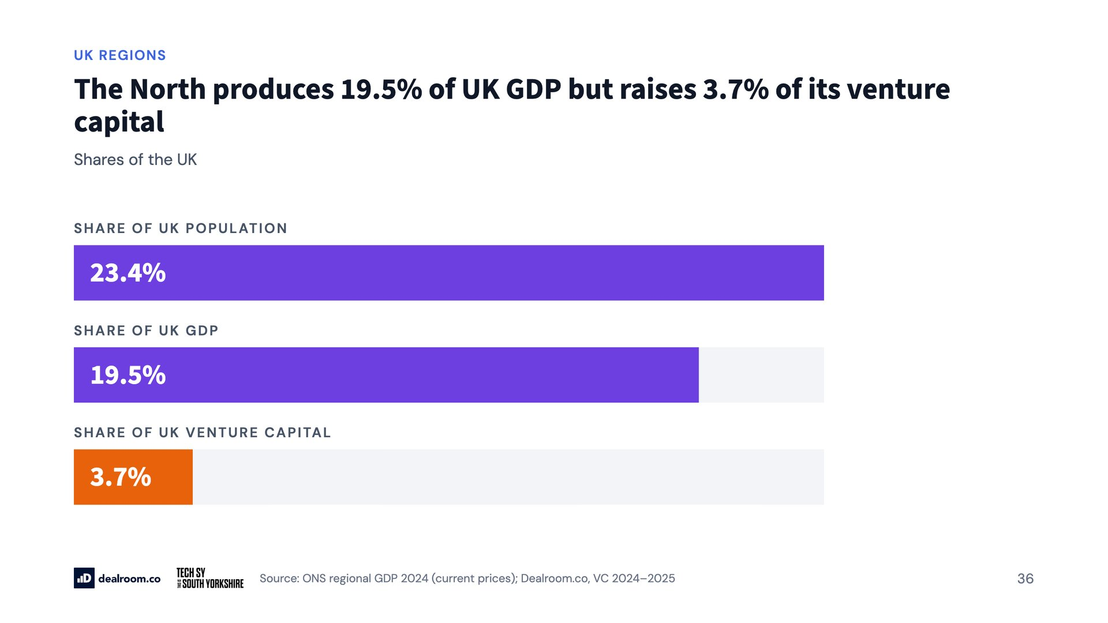
Notes:
The North produces 19.5% of UK GDP but raises 3.7% of its venture capital

Slide 37
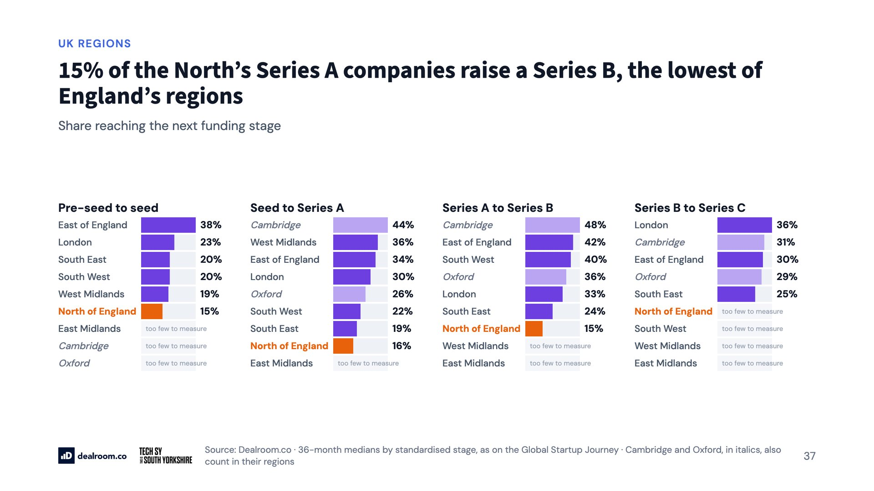
Notes:
15% of the North’s Series A companies raise a Series B, the lowest of England’s regions

Slide 38
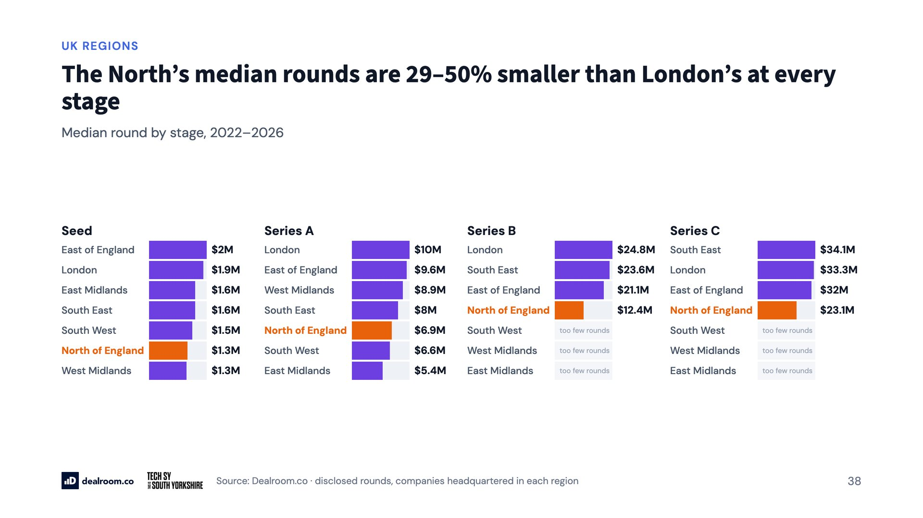
Notes:
The North’s median rounds are 29–50% smaller than London’s at every stage

Slide 39
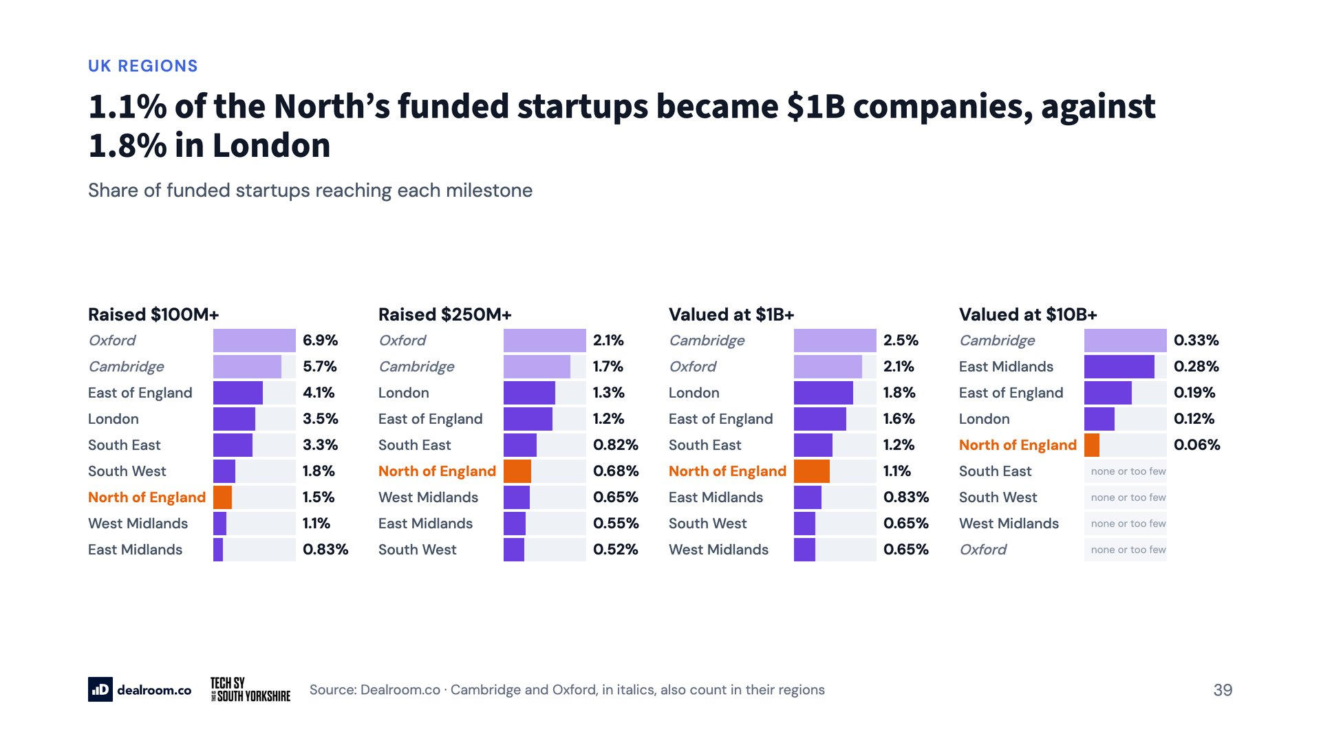
Notes:
1.1% of the North’s funded startups became $1B companies, against 1.8% in London

Slide 40
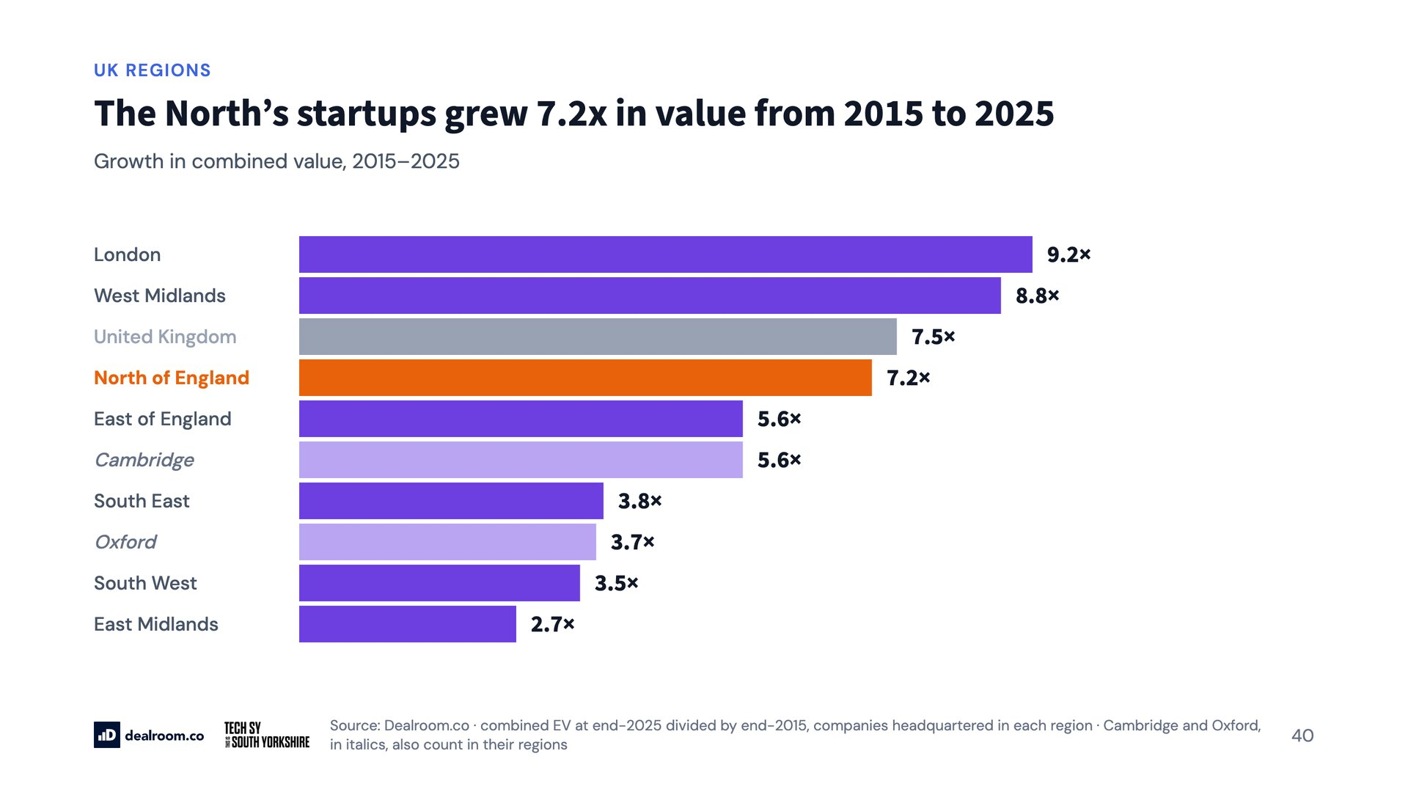
Notes:
The North’s startups grew 7.2x in value from 2015 to 2025

Slide 41
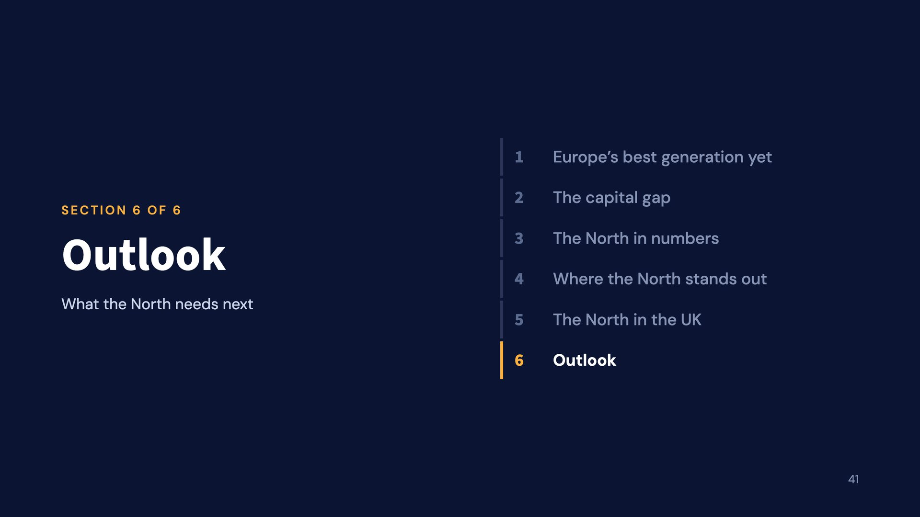
Notes:
Outlook

Slide 42
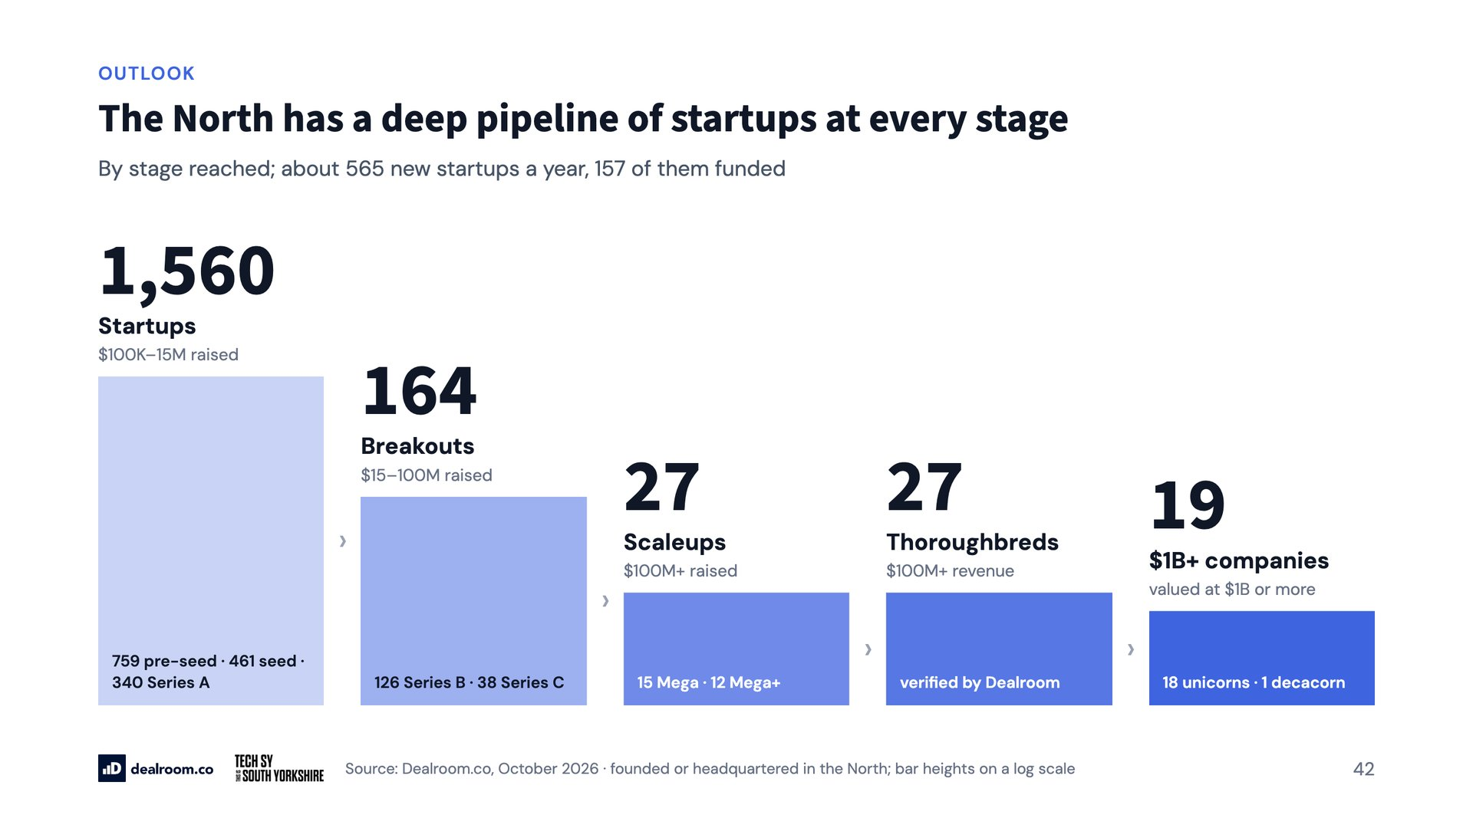
Notes:
The North has a deep pipeline of startups at every stage

Slide 43
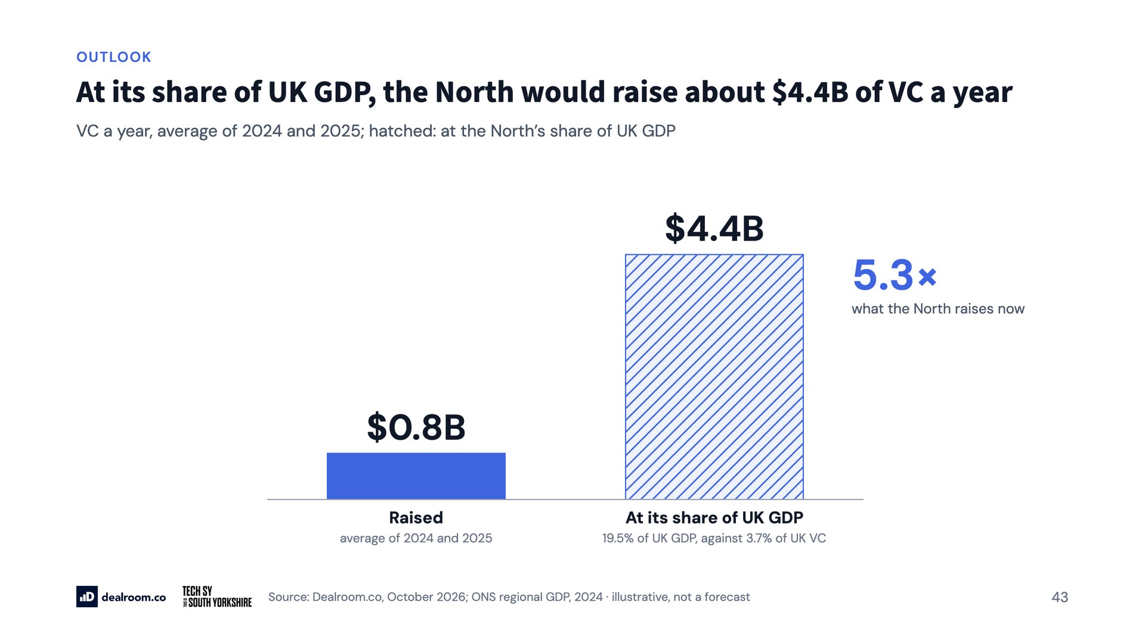
Notes:
At its share of UK GDP, the North would raise about $4.4B of VC a year

Slide 44
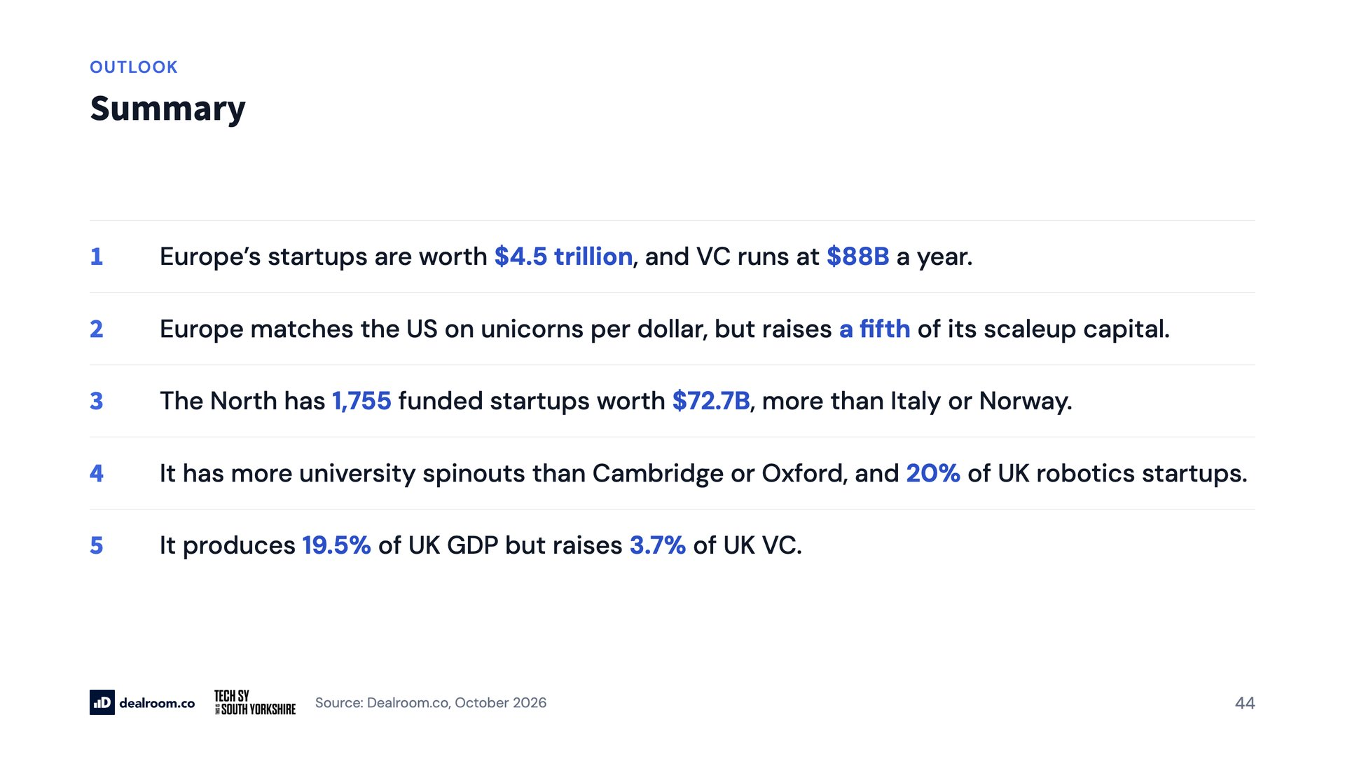
Notes:
Summary

Slide 45

Notes:
Dealroom.co

